Slide 1
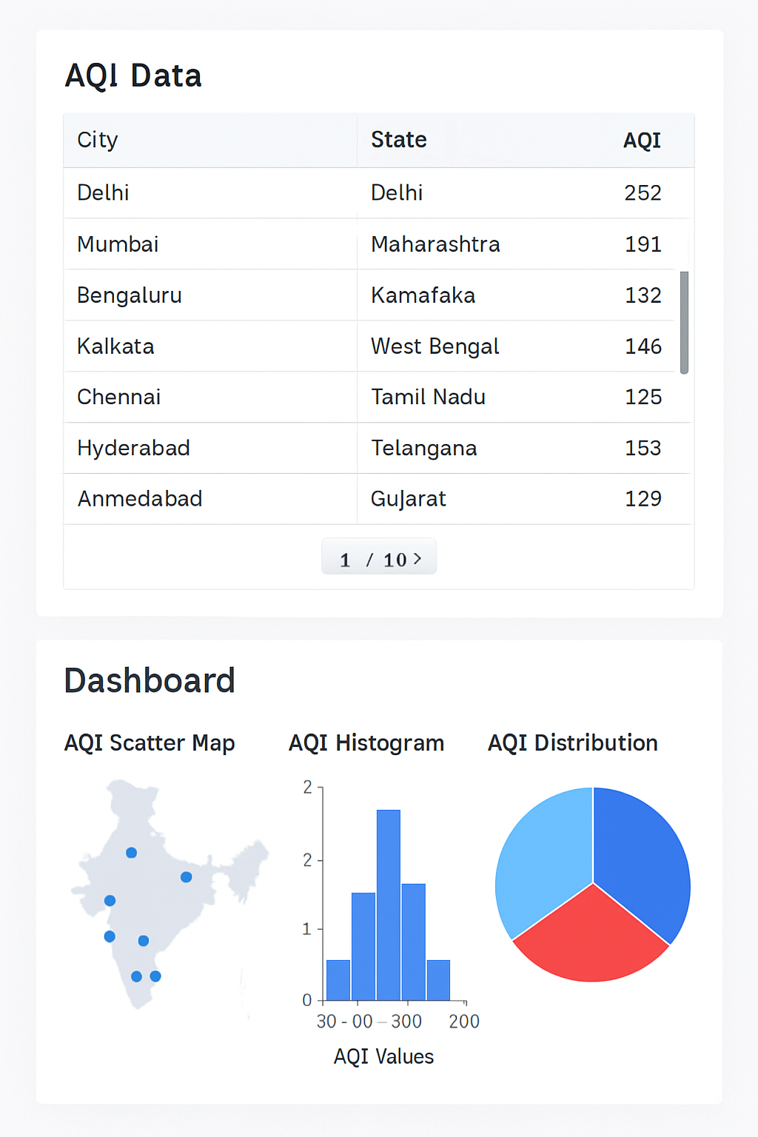
NAME: ARPAN CHATTERJEE
Roll: 2312RES162
Adm. No: IITP000646
4th SEM BSc. CSDA
GUVI + HCL SUMMER INDUSTRY INTERNSHIP
Email-id: arpan_2312res162@iitp.ac.in
GitHub Link: https://github.com/ArpanC03/Guvi-Project-1-Data-Science

Slide 2
DATA SCIENCE INTERN
Problem Statement 5:
AQI Mapping of Indian Cities
Mapping of AQI readings using geospatial visualizations.
Choropleth map by AQI
Tooltip: City name + AQI
AQI filter: Good, Moderate, Poor

Slide 3
DESCRIPTION
Air pollution in Indian cities is a major environmental and health concern, but city-level AQI data is complex, scattered, and difficult for citizens or policymakers to interpret quickly.
Our goal: Build an interactive dashboard that streamlines exploration, visualization, and analysis of real AQI data for all major Indian cities, to empower evidence-driven action and awareness.

Slide 4
OBJECTIVES
- Aggregate, clean, and categorize AQI data for Indian cities, ensuring consistency and accuracy.
- Enable easy visual exploration of air quality by city, state, and AQI category.
- Provide actionable insights—top/bottom ranked cities, category-wise breakdowns, and distribution analysis—for diverse stakeholders.
- Share the project openly as a reproducible workflow and dashboard.

Slide 5
DATA PIPELINE AND WORKFLOW
1. Data Collection:
- Gather raw AQI data (CSV/online sources).
2. Data Preparation in Google Colab:
- Cleanse, validate, and categorize AQI values programmatically (Python).
3. Visualization & Dashboard:
- Instantly explore data using interactive dashboards:
- Google Colab (Python/Plotly visuals)
- Power BI (interactive mapping, charts, slicers)
- Streamlit (web-based app/dashboard)
4. Share & Reproduce:
- All files and code available openly via GitHub.

Slide 6
1. Data Collection:
- Gather raw AQI data (CSV/online sources).
2. Data Preparation in Google Colab:
- Cleanse, validate, and categorize AQI values programmatically (Python).
3. Visualization & Dashboard:- Instantly explore data using interactive dashboards:
- Google Colab (Python/Plotly visuals)
- Power BI (interactive mapping, charts, slicers)
- Streamlit (web-based app/dashboard)
4. Share & Reproduce:
- All files and code available openly via GitHub.

Slide 7
KEY FEATURES
- Scrollable, filterable city-state AQI table for instant lookup.
- Dynamic KPIs: total cities, average AQI, most/least polluted city at a glance.
- Interactive map of India with color-coded AQI markers.
- Distribution plots, city ranking charts, and categorical breakdowns.
- One-click reproducibility: all dashboards work from one dataset.

Slide 8
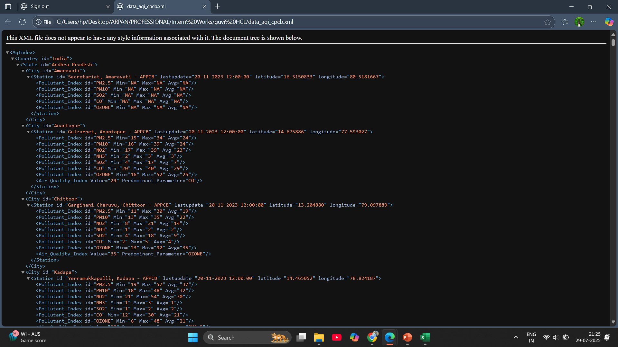

Slide 9
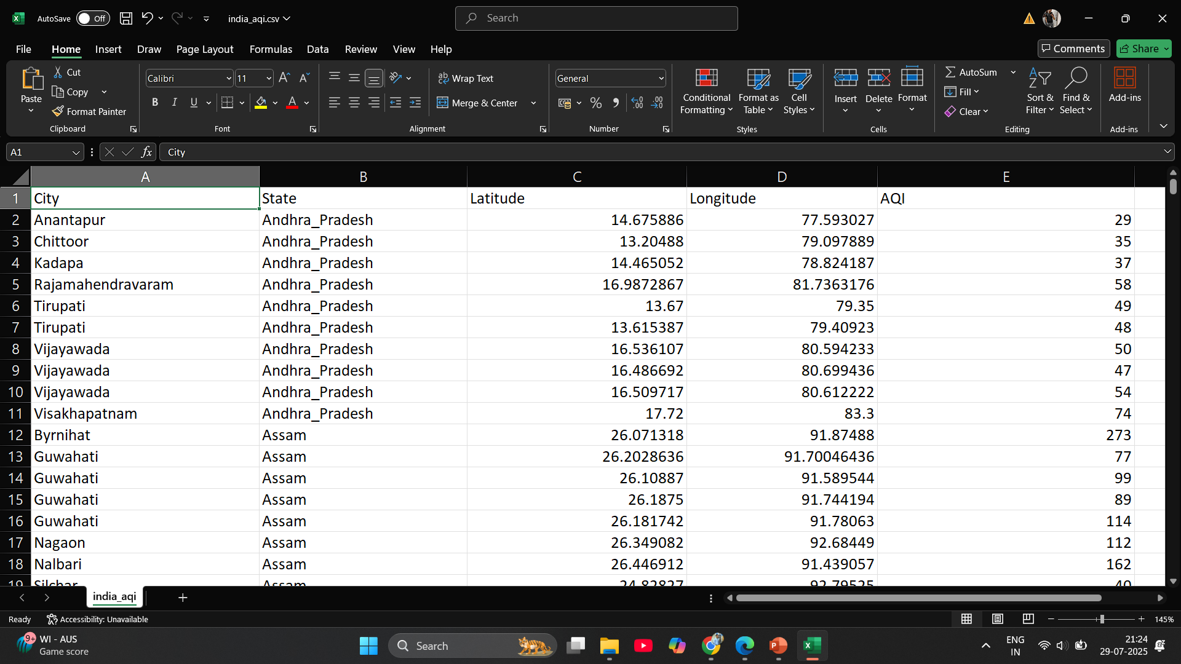

Slide 10
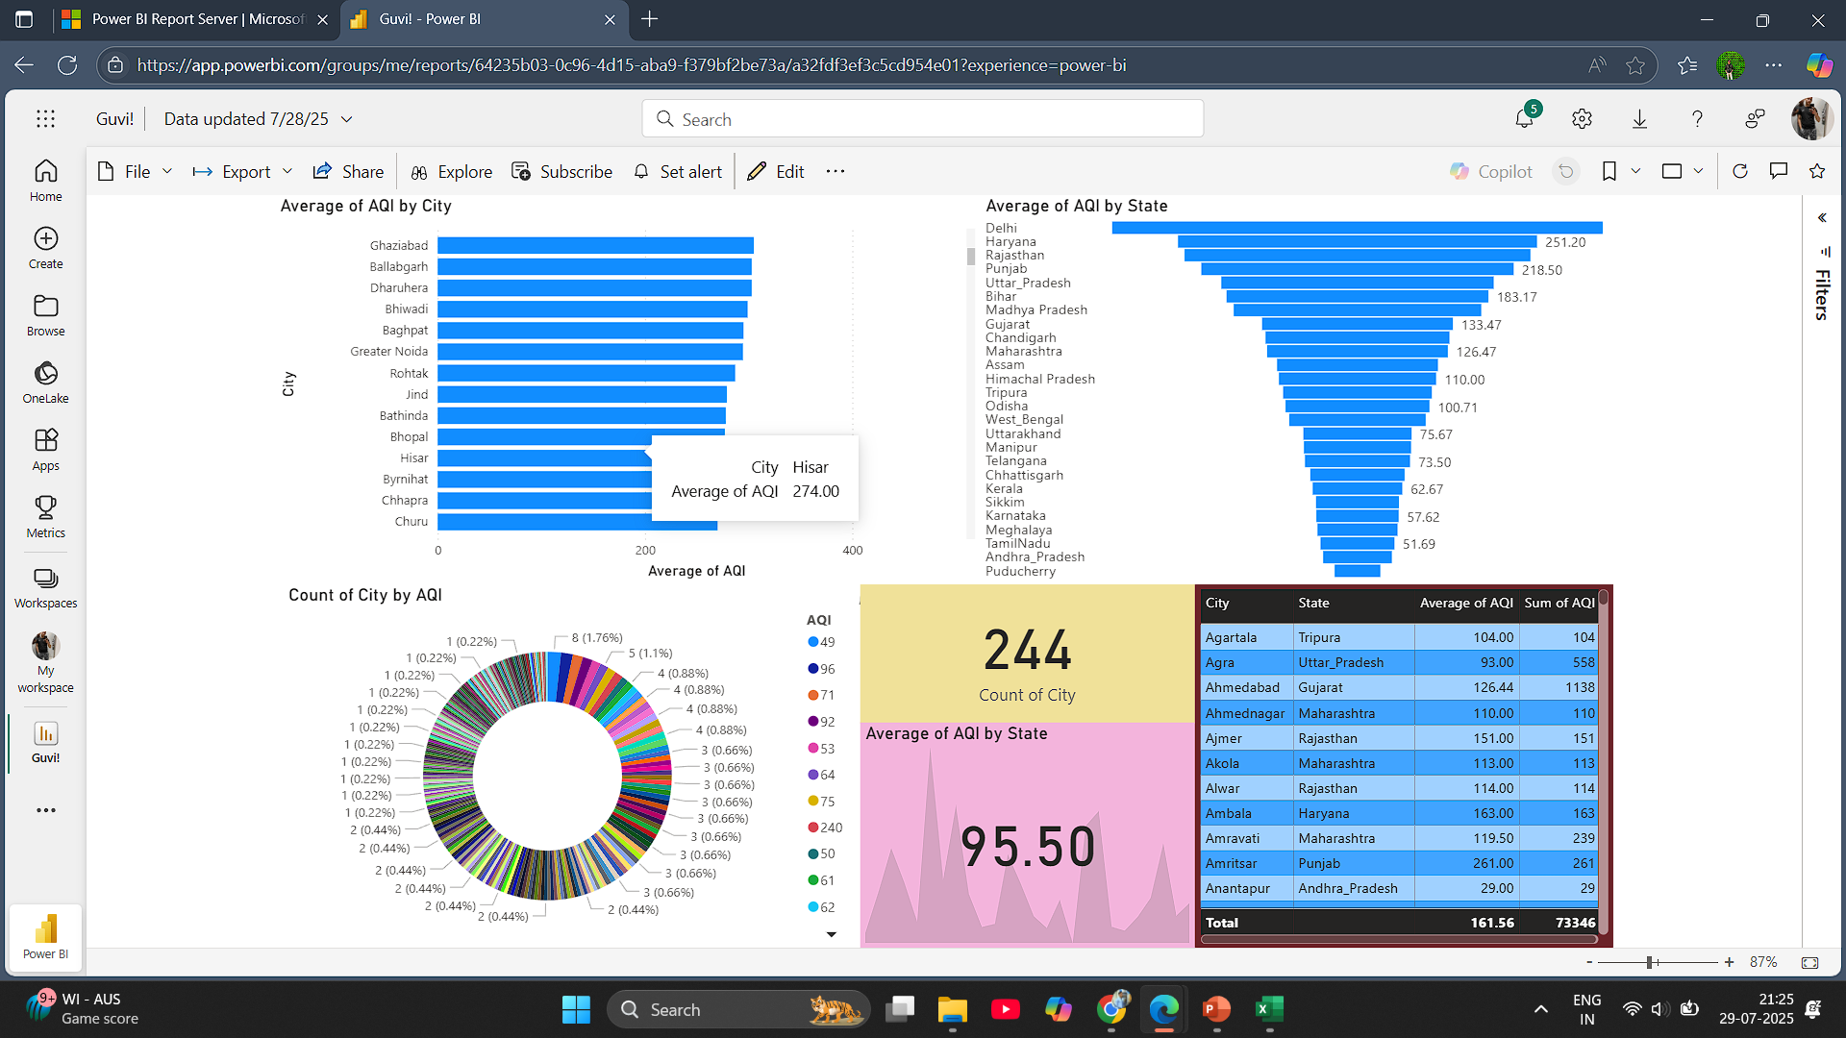

Slide 11
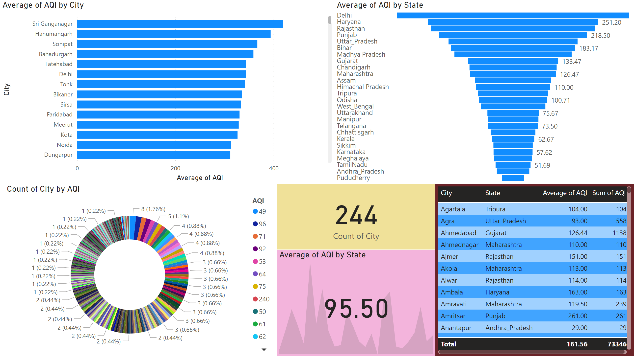
Page 1
Notes:
barChart
No alt text provided
kpi
No alt text provided
card
No alt text provided
funnel
No alt text provided
tableEx
No alt text provided
donutChart
No alt text provided

Slide 12
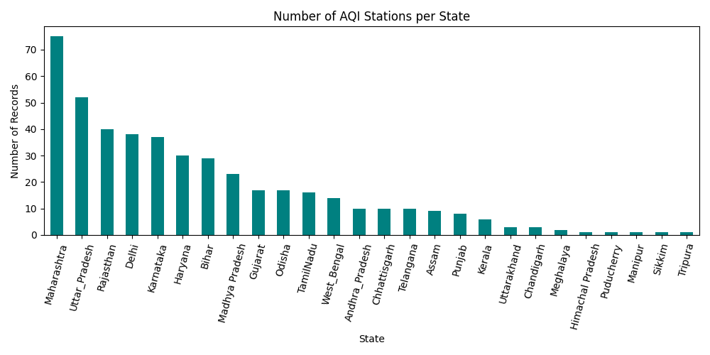
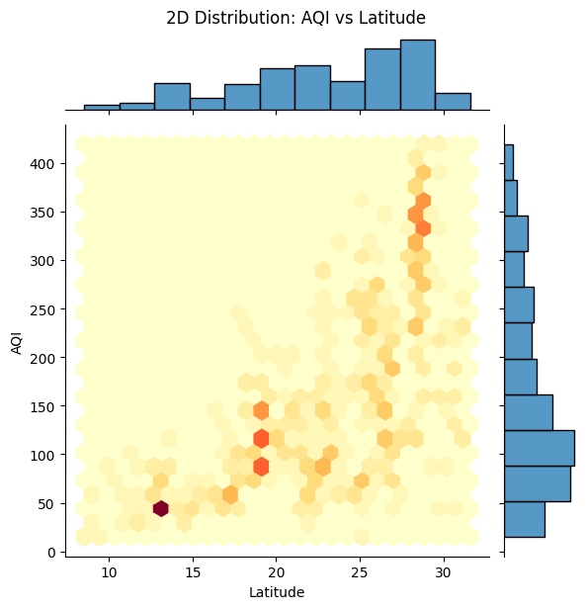
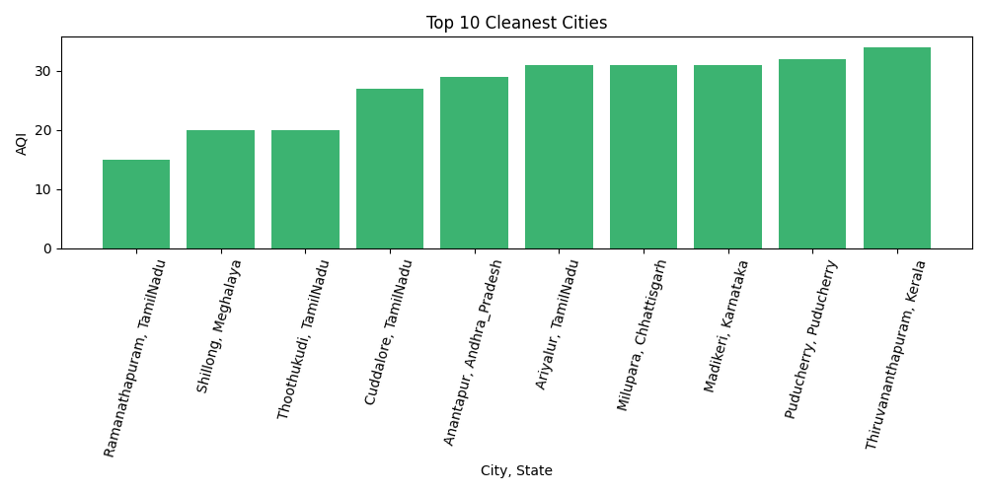

Slide 13
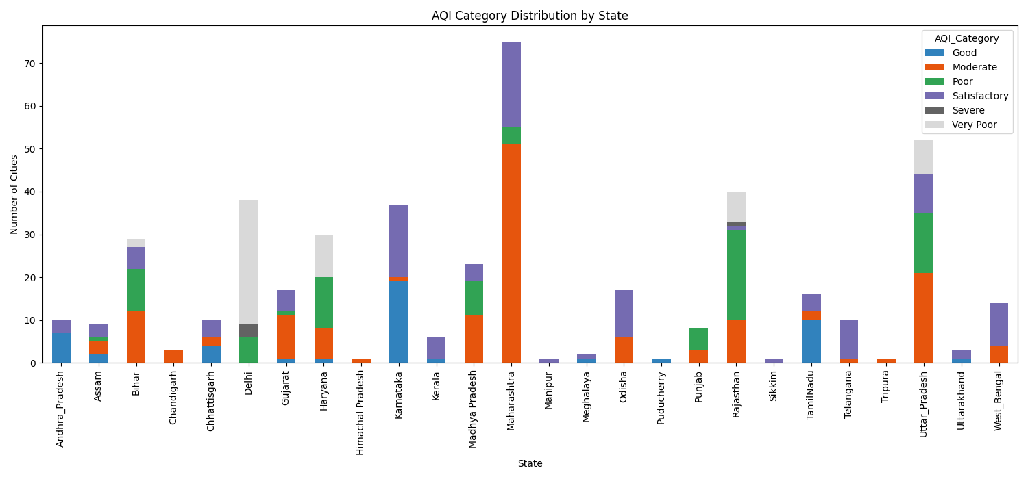
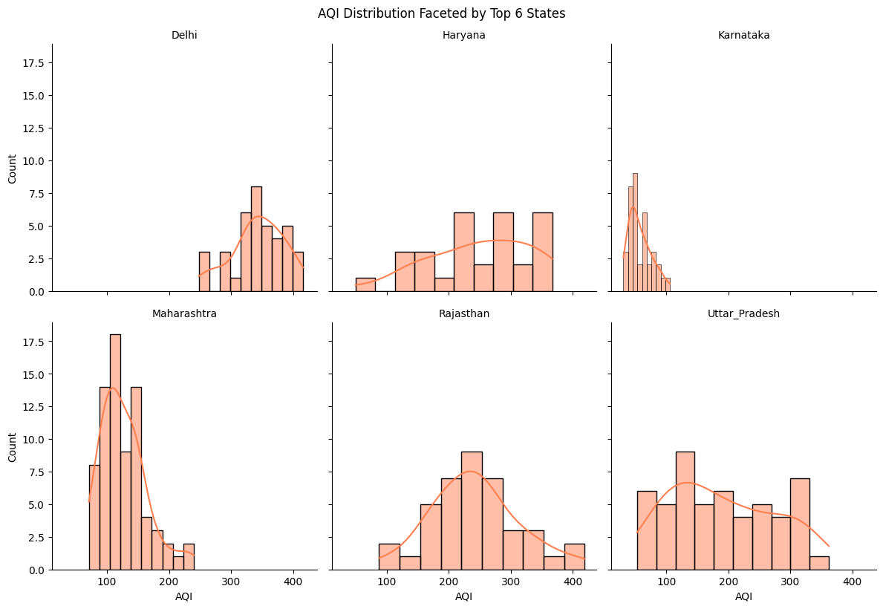
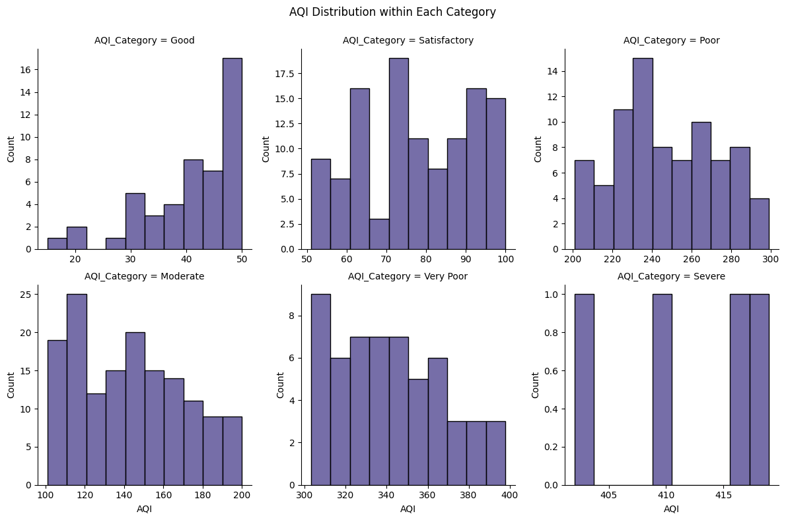
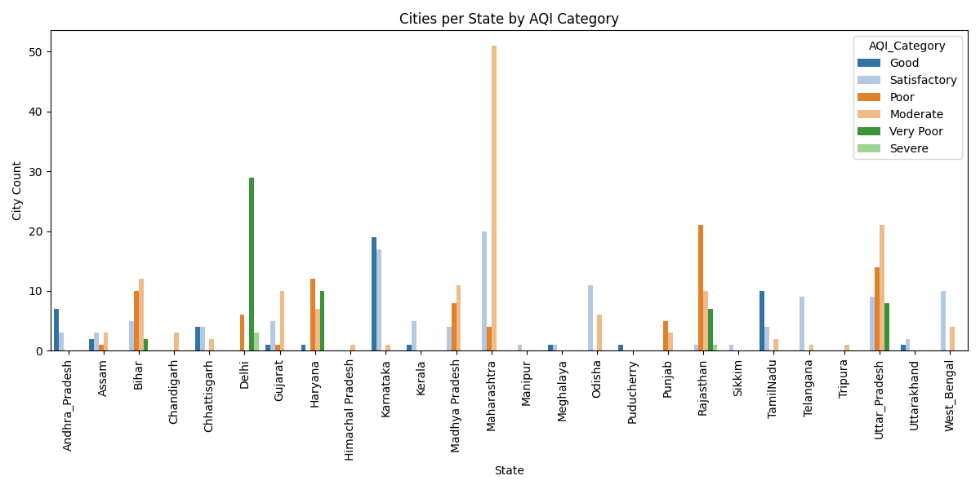

Slide 14
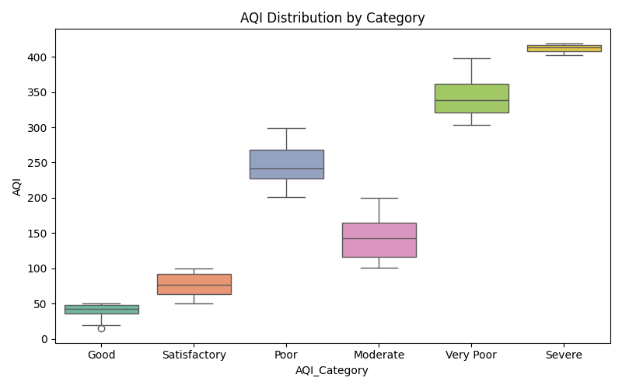
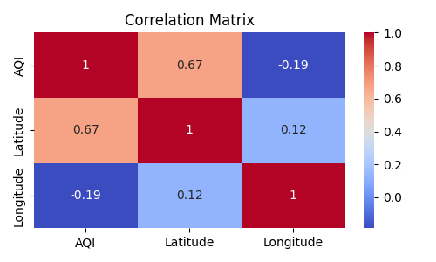
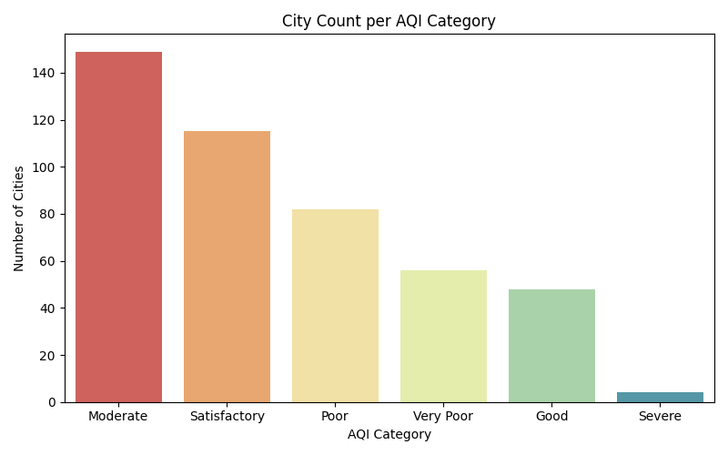
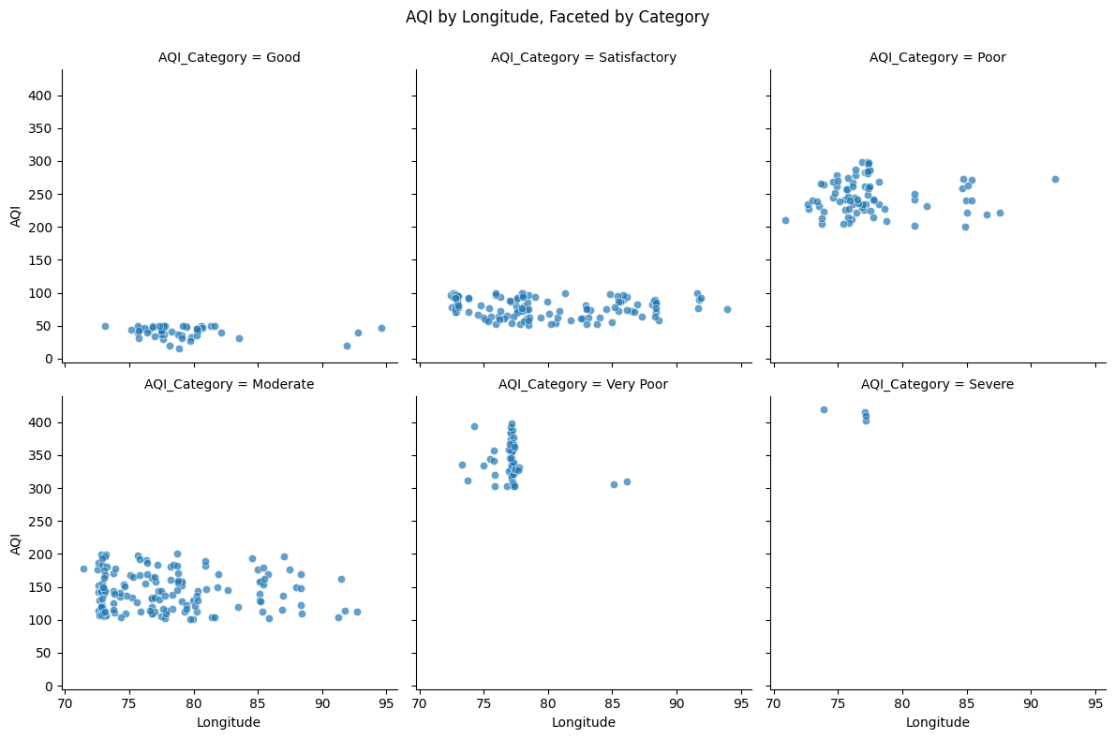
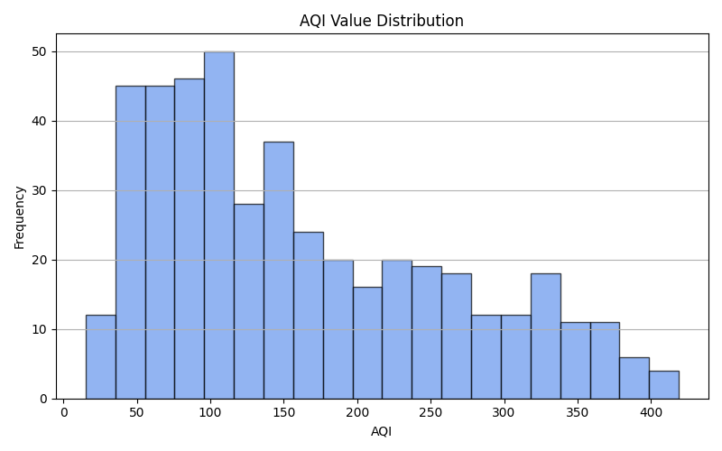

Slide 15
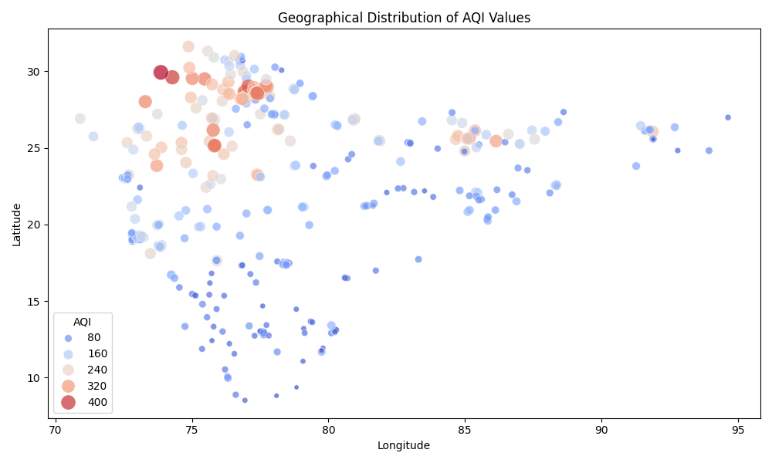
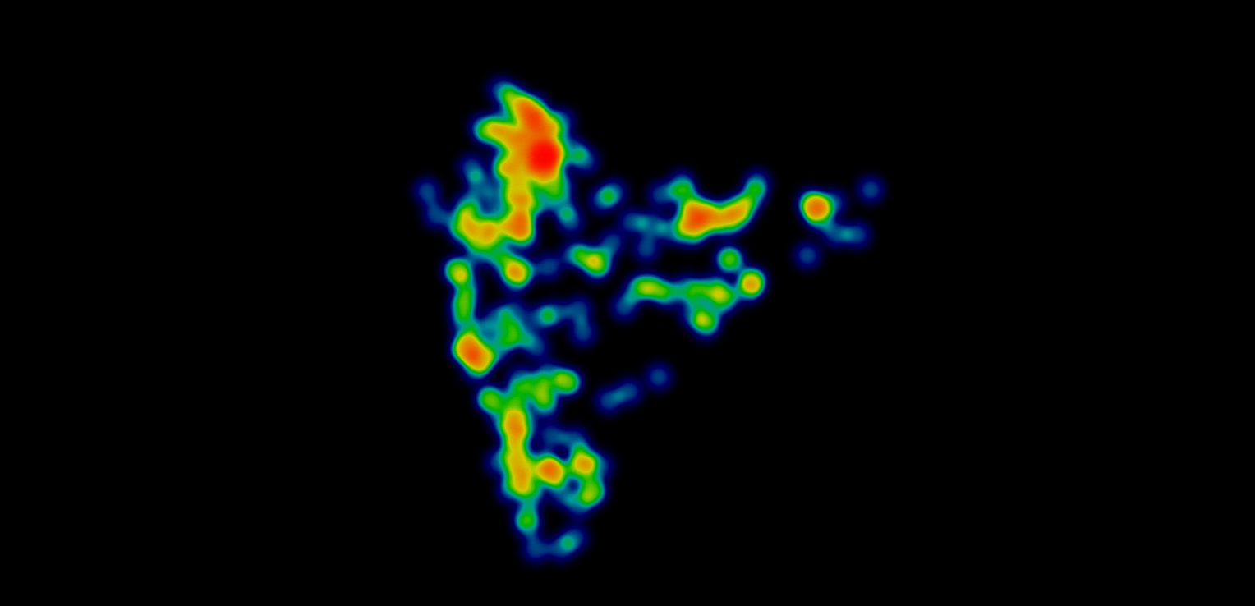
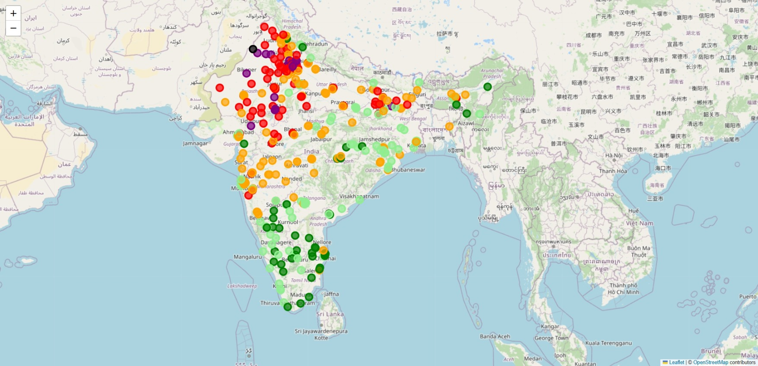
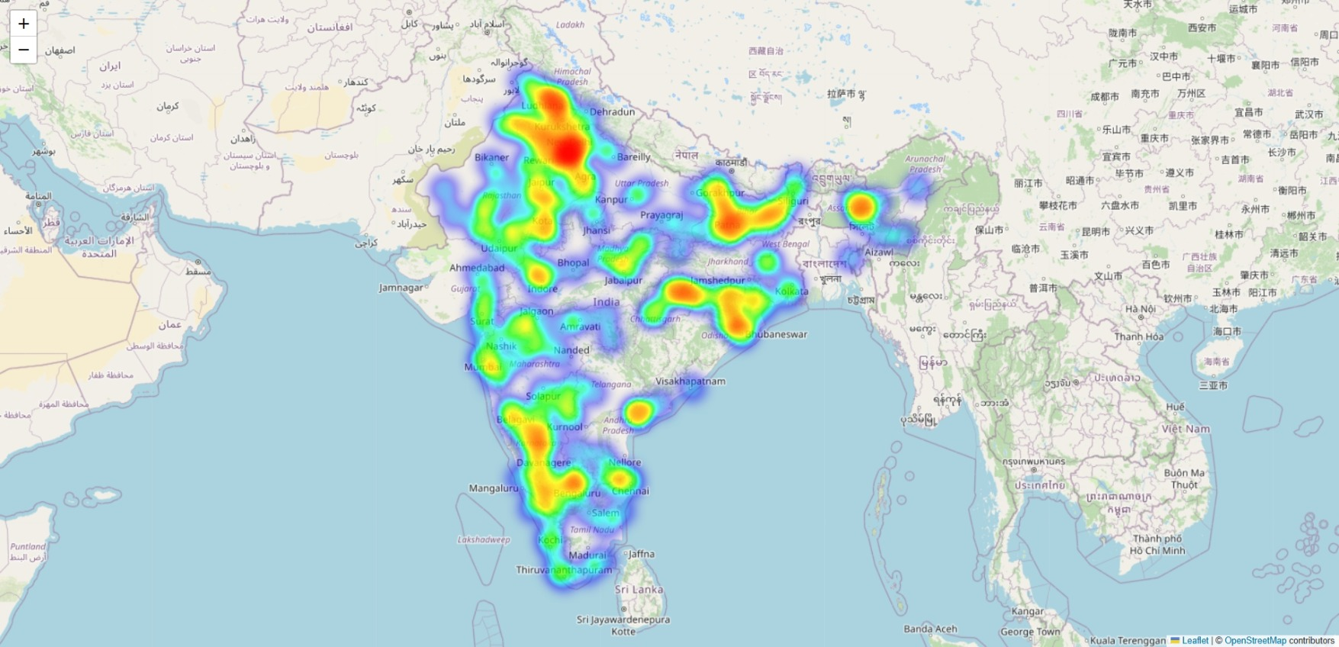

Slide 16
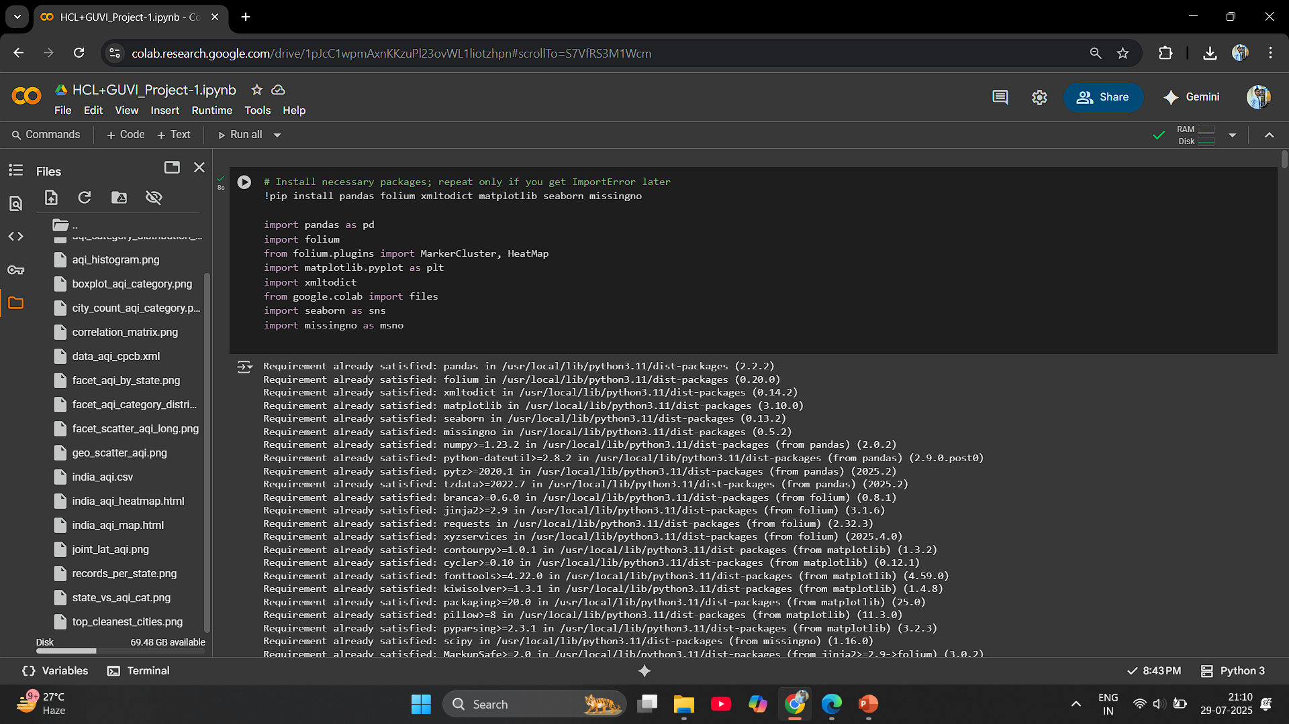

Slide 17
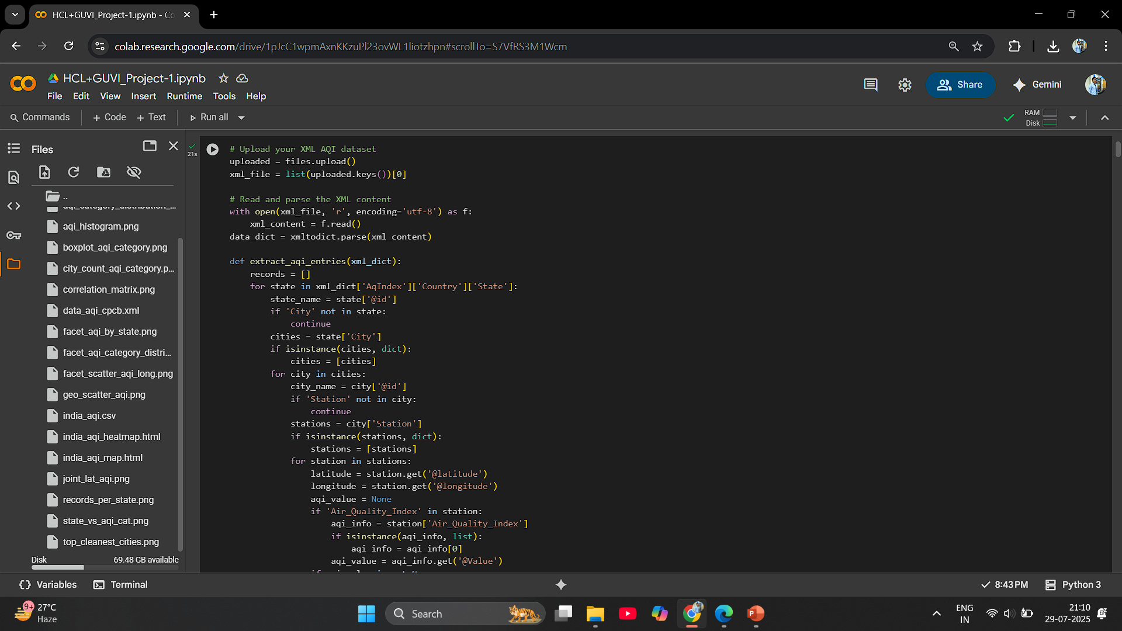

Slide 18
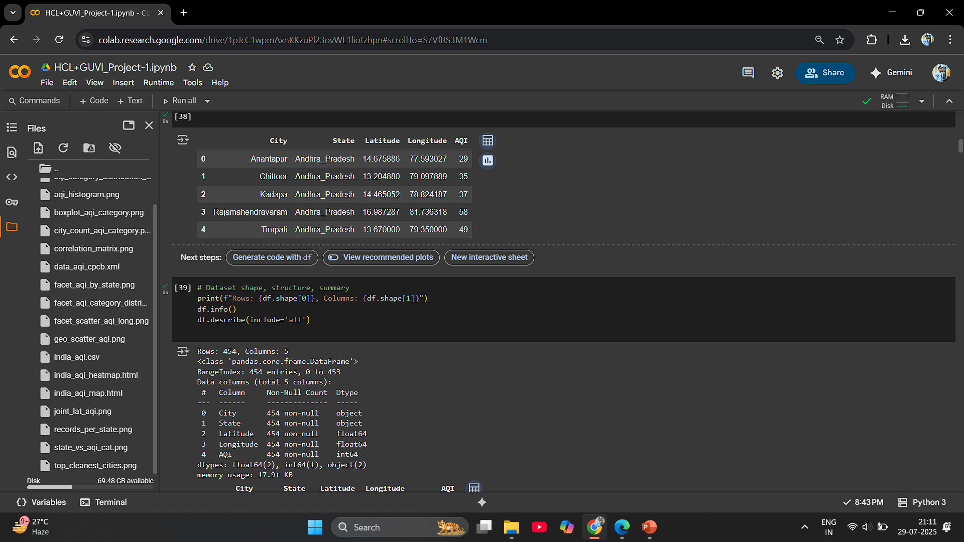

Slide 19
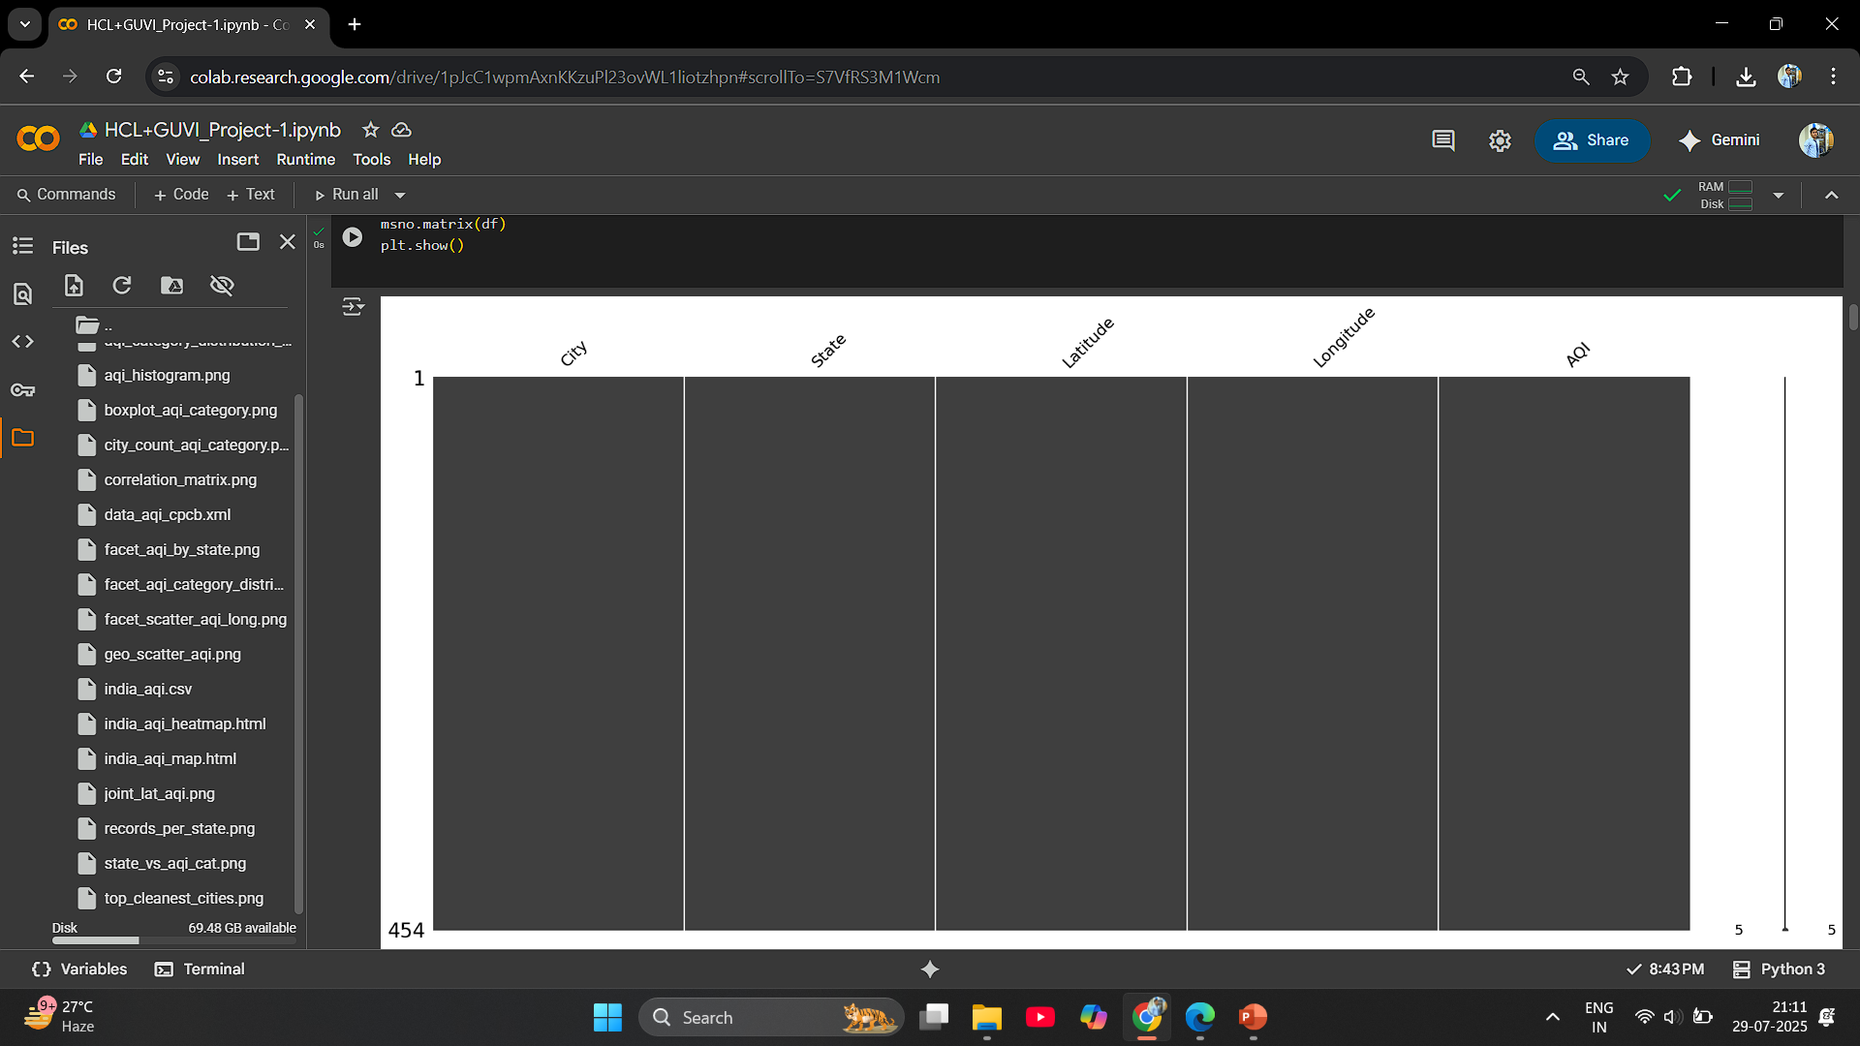

Slide 20
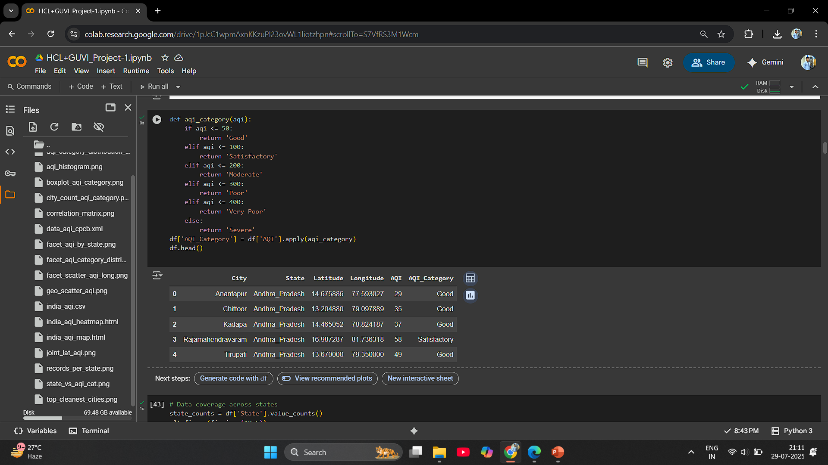

Slide 21
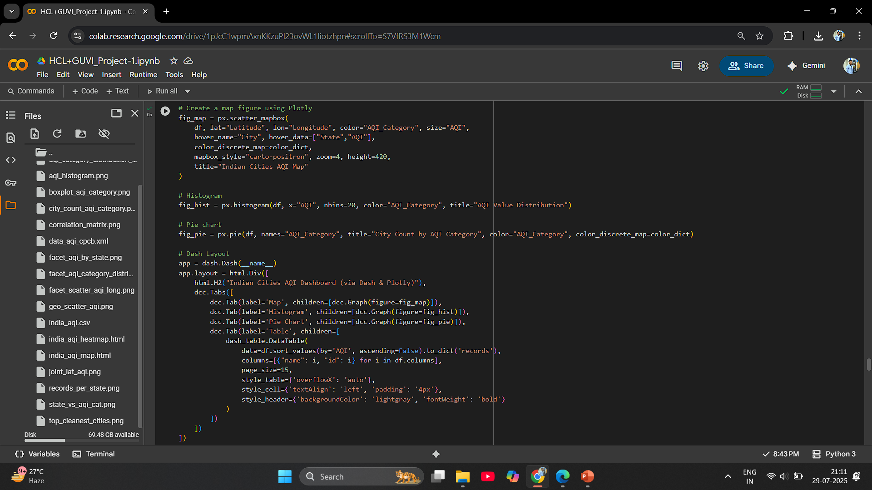

Slide 22
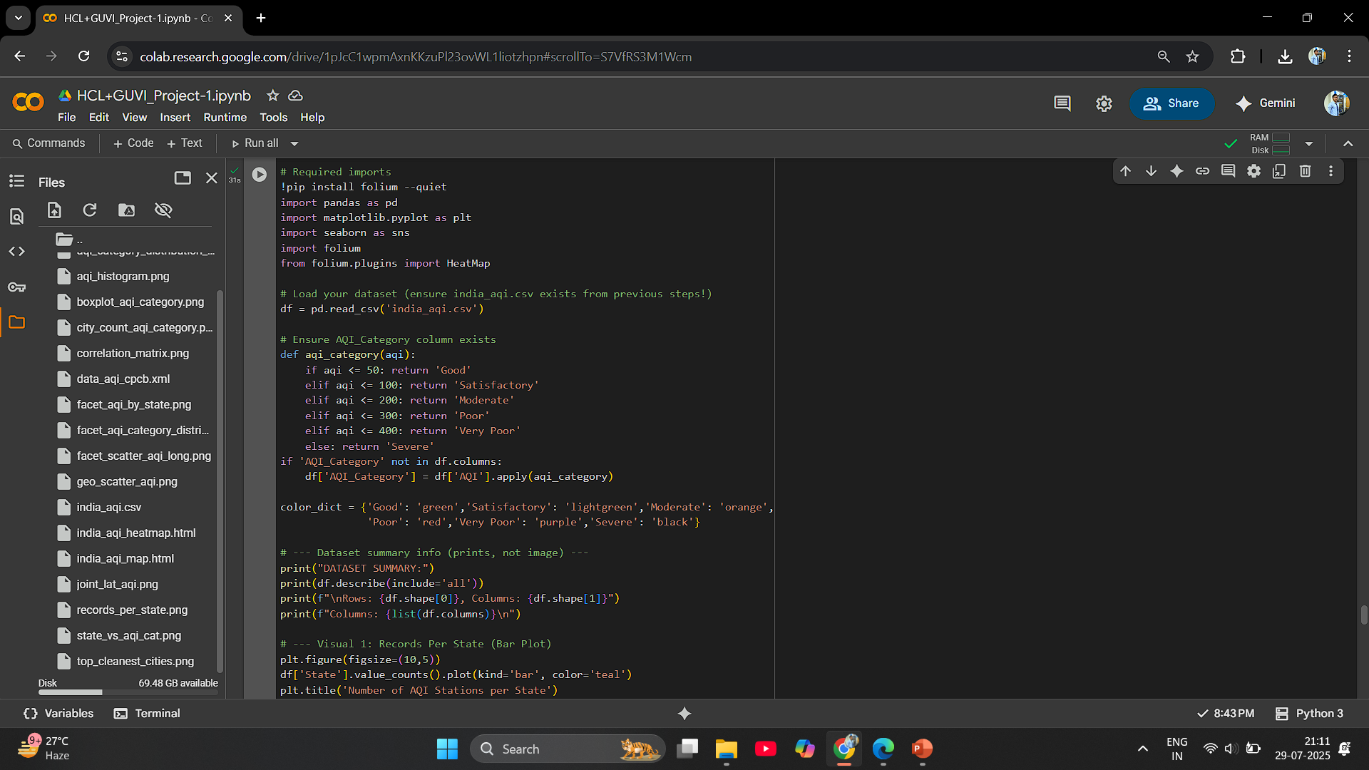

Slide 23
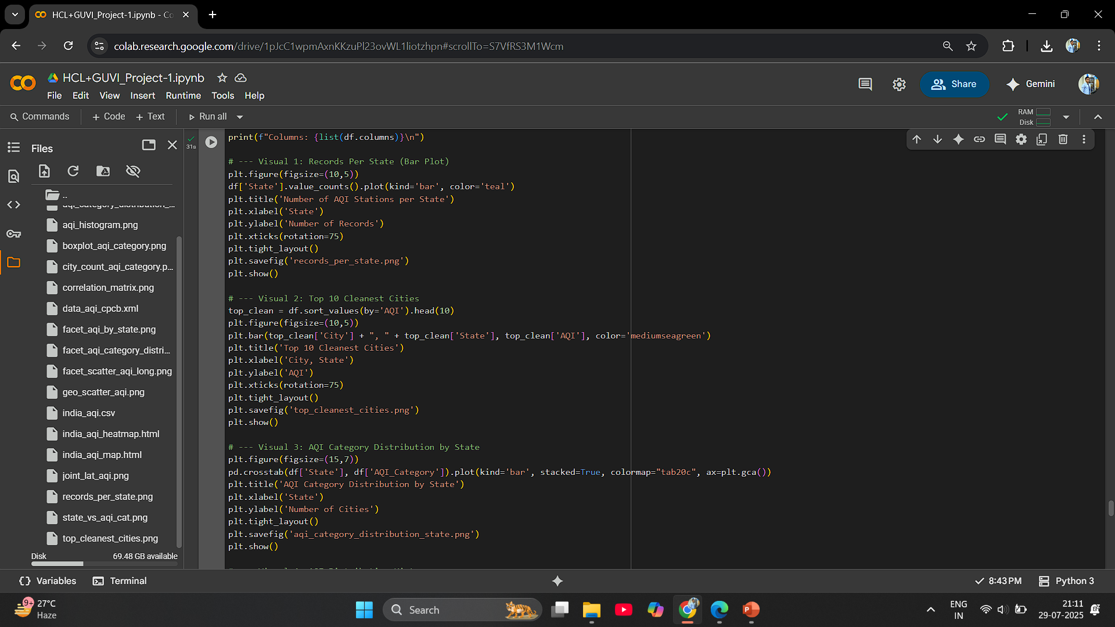

Slide 24
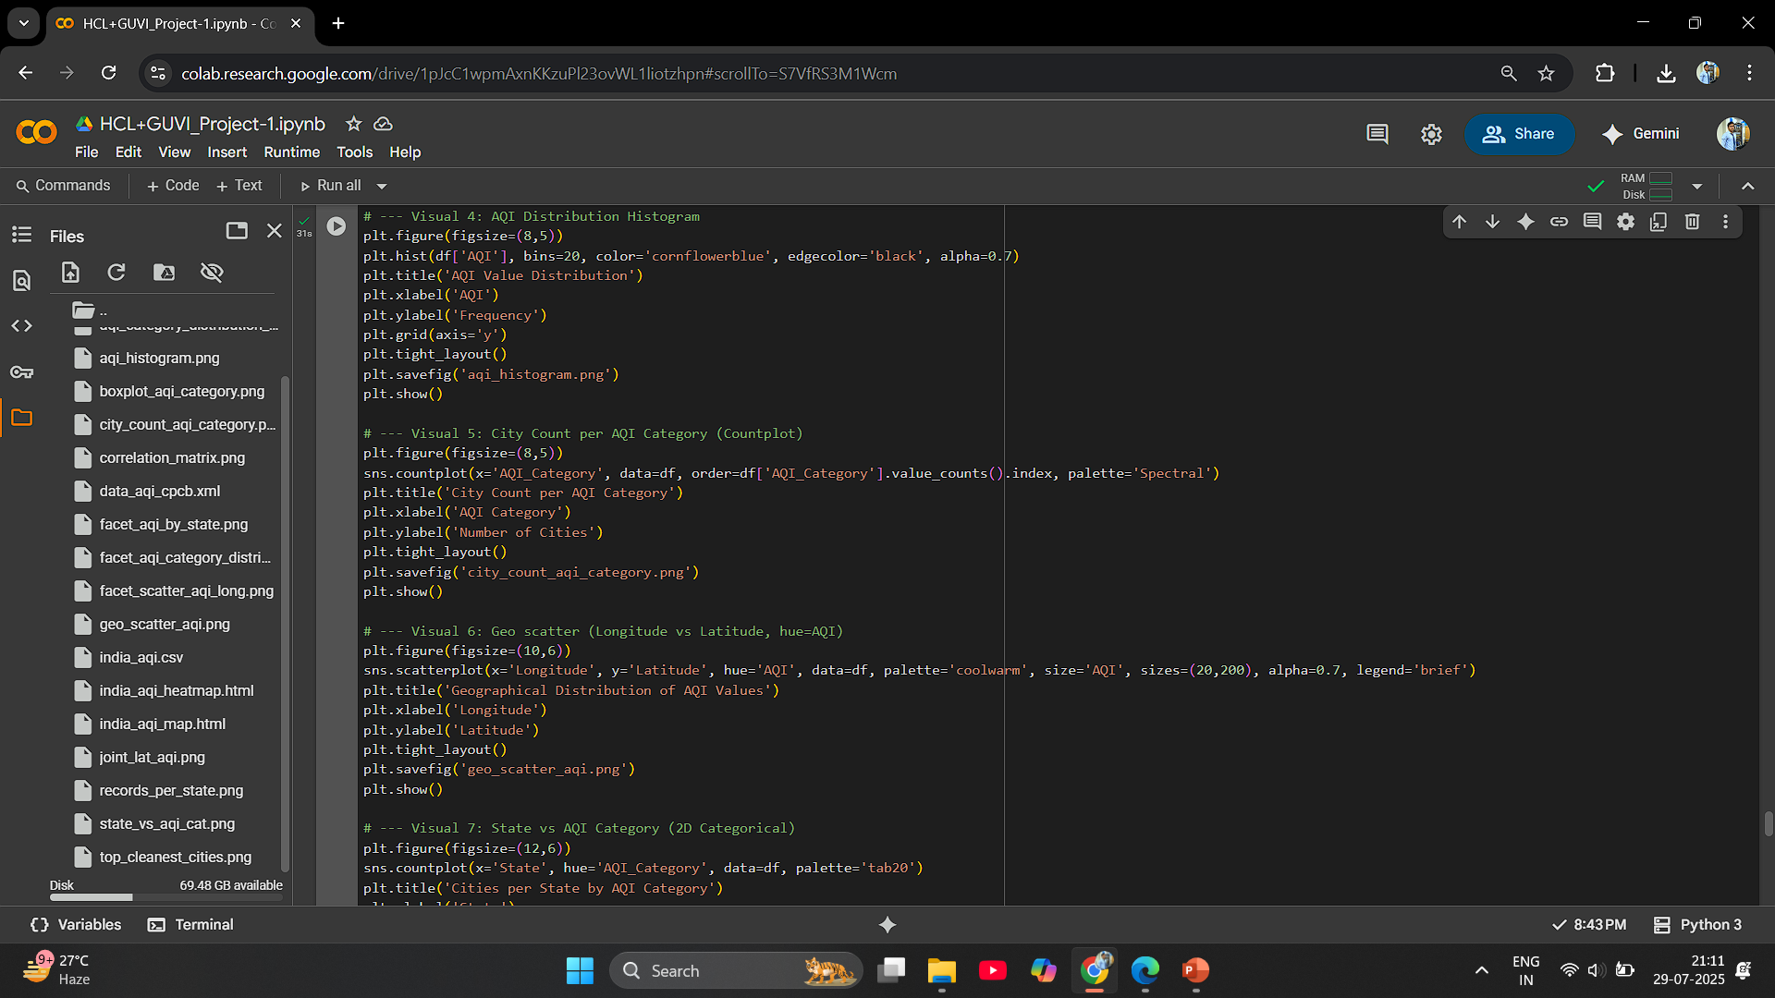

Slide 25
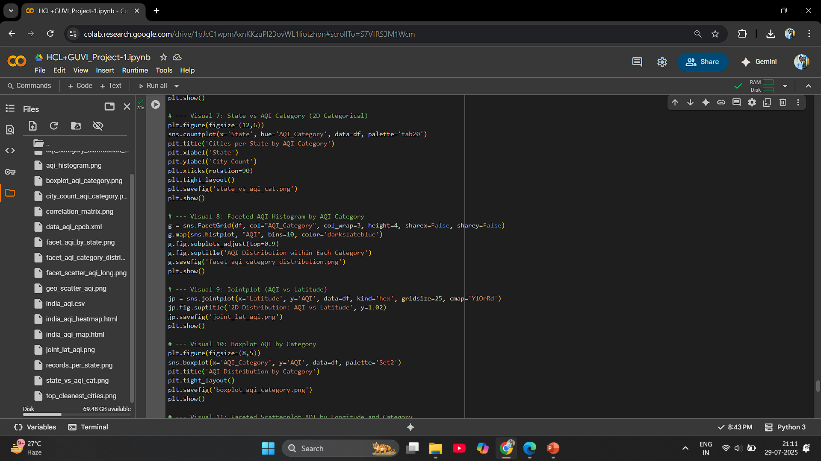

Slide 26
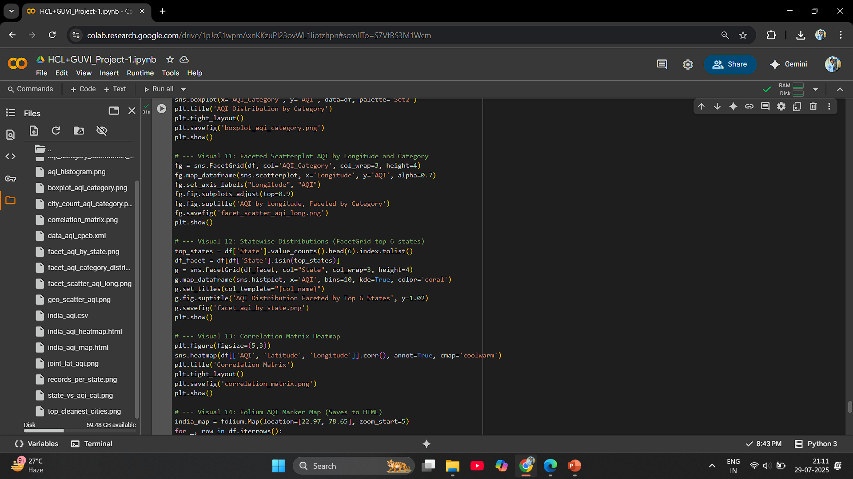

Slide 27
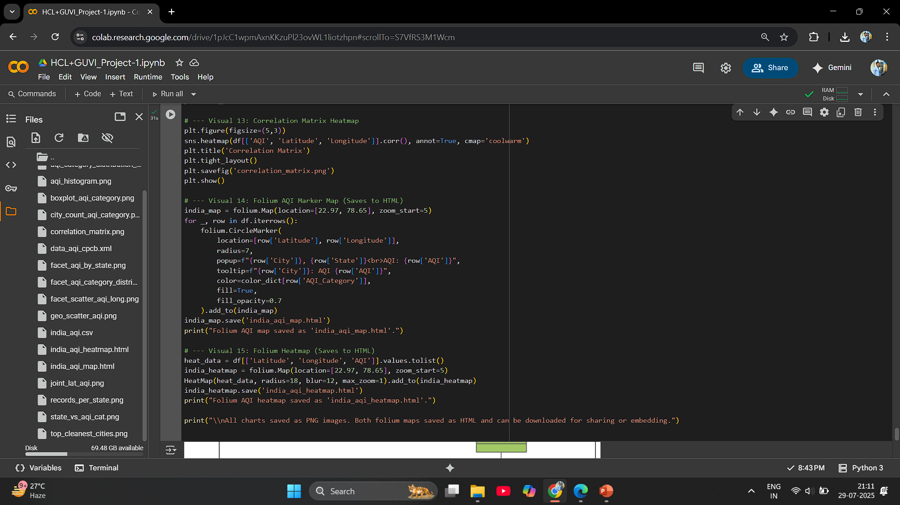

Slide 28
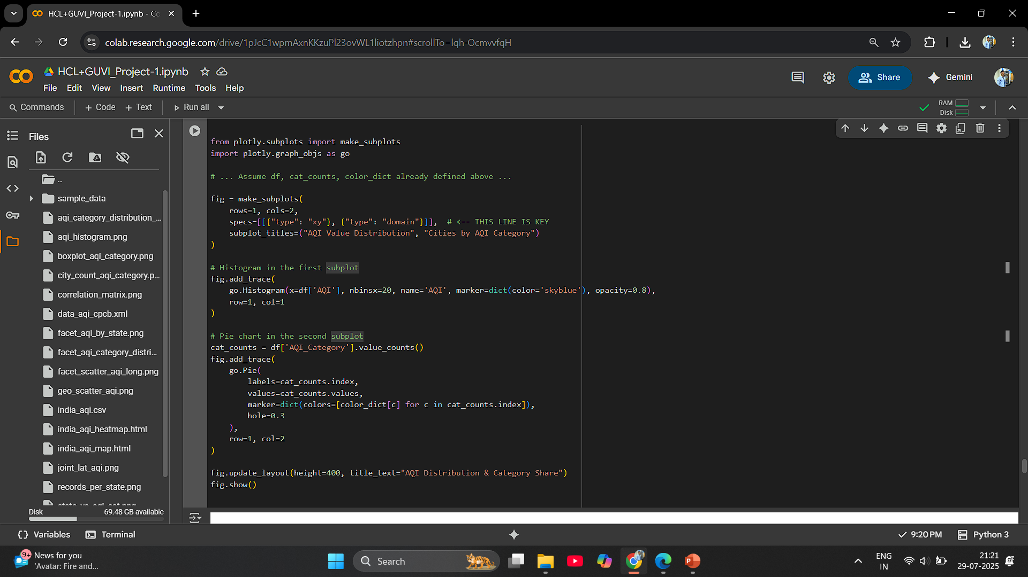

Slide 29
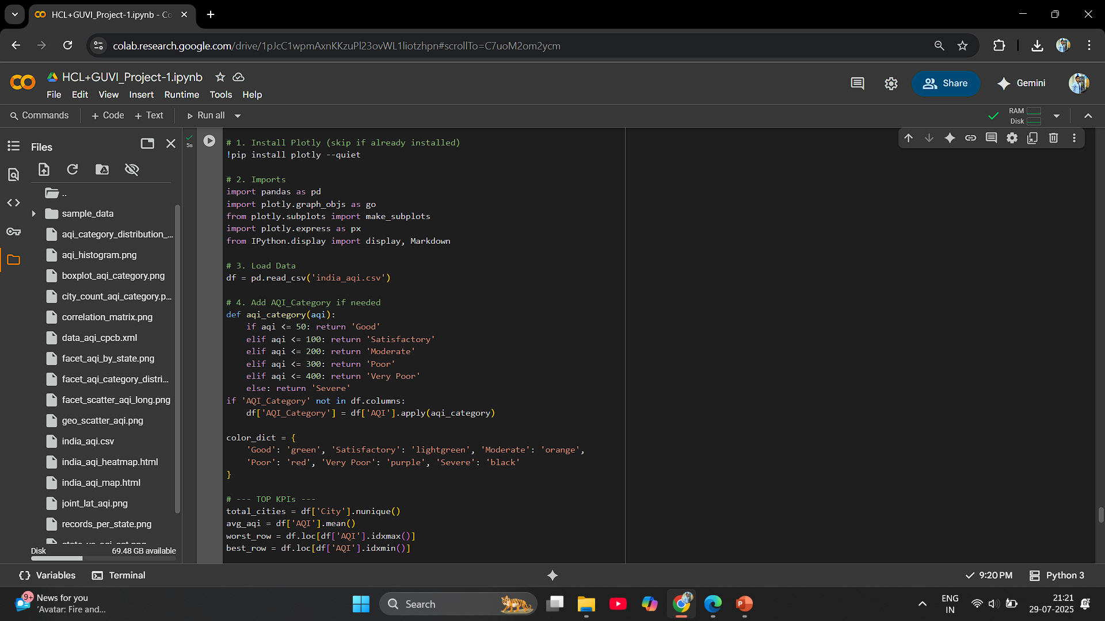

Slide 30
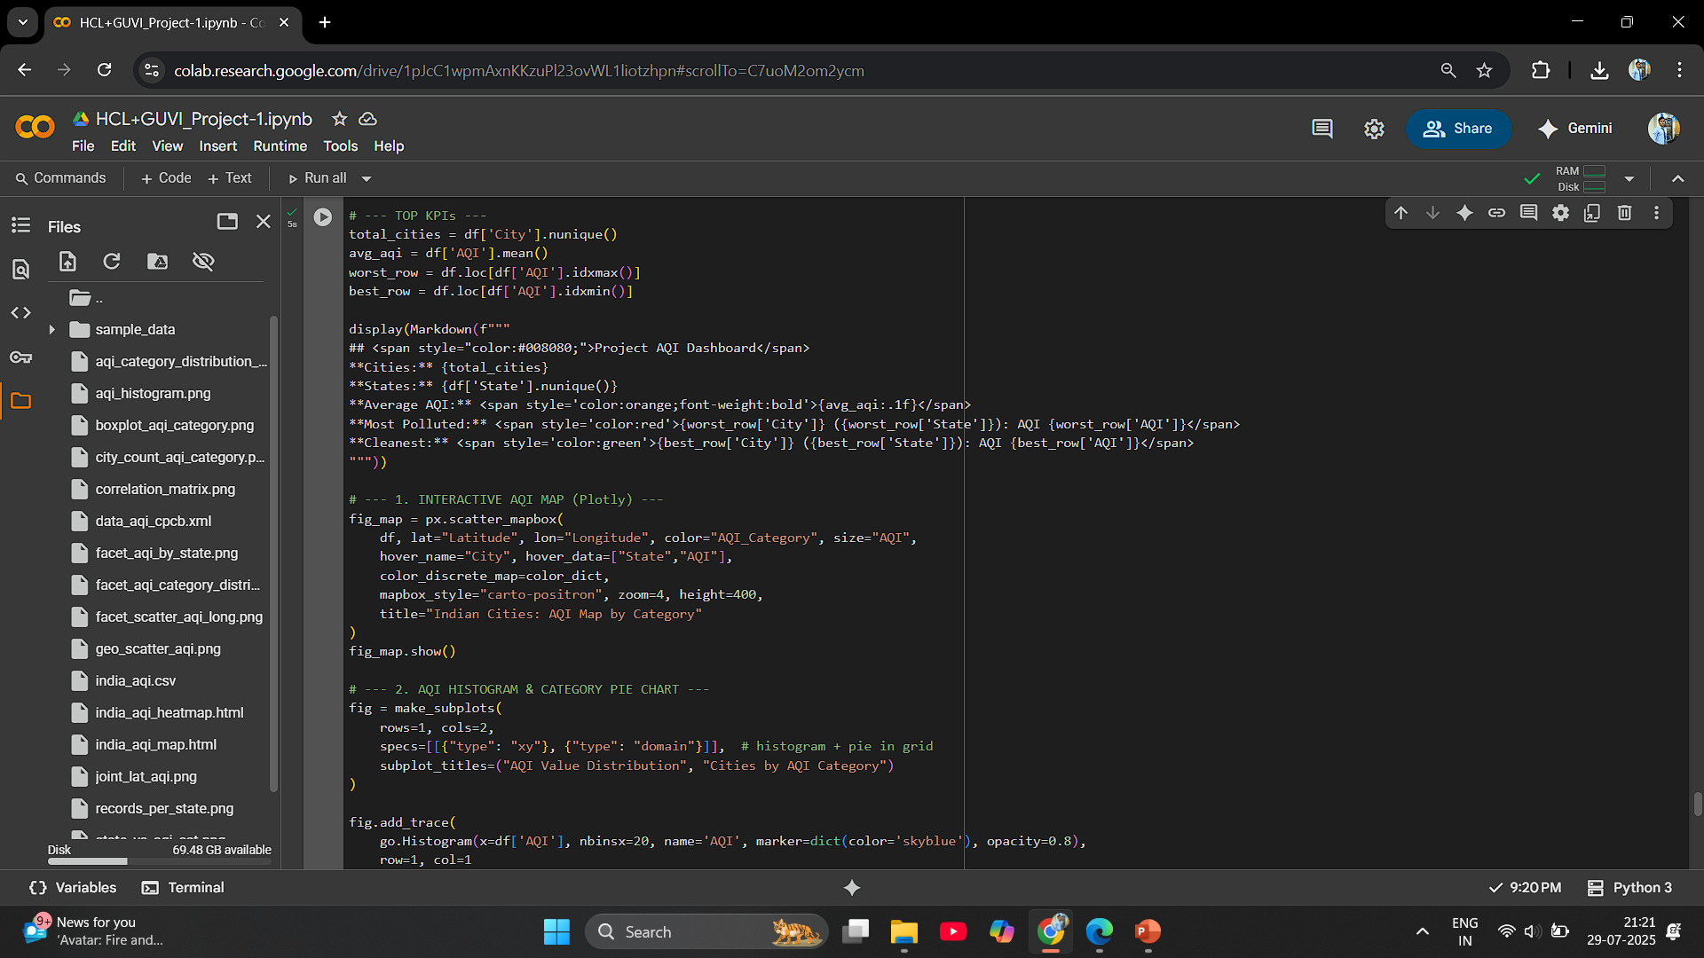

Slide 31


Slide 32
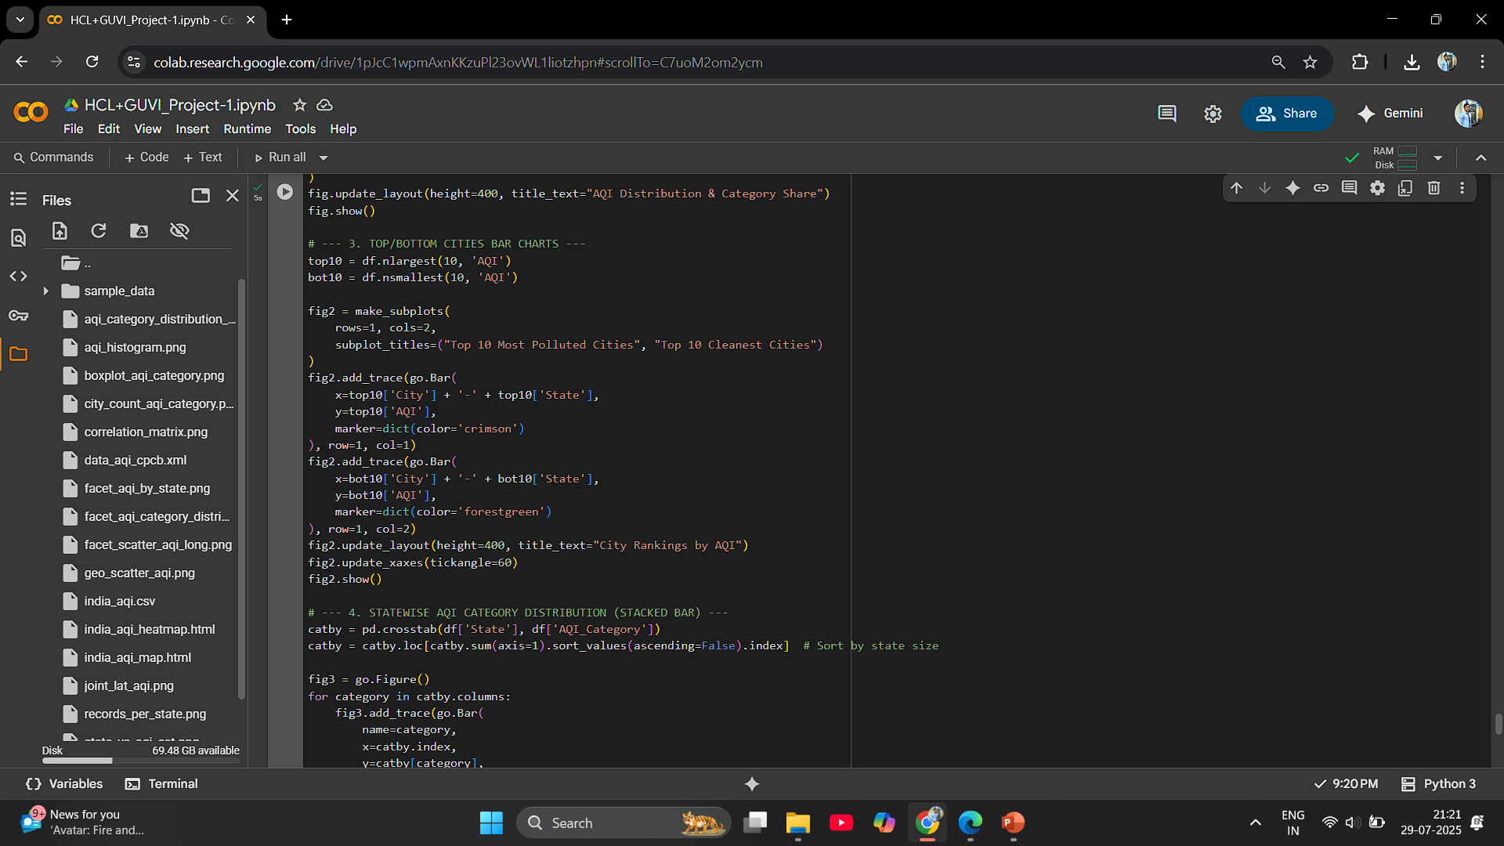

Slide 33
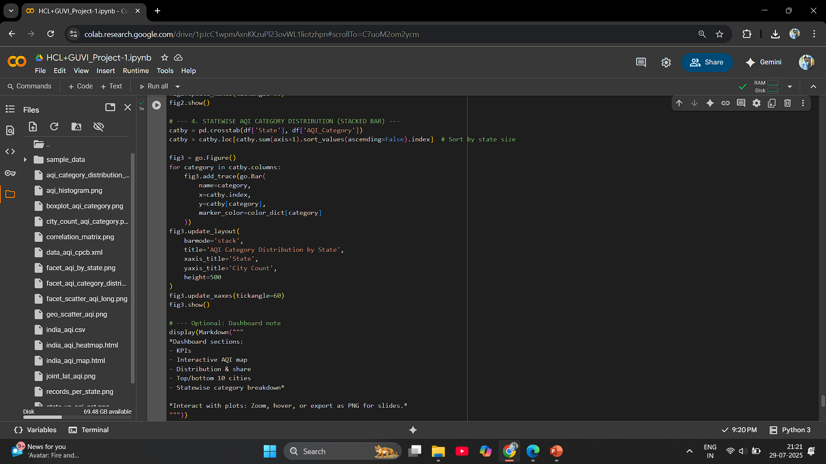

Slide 34
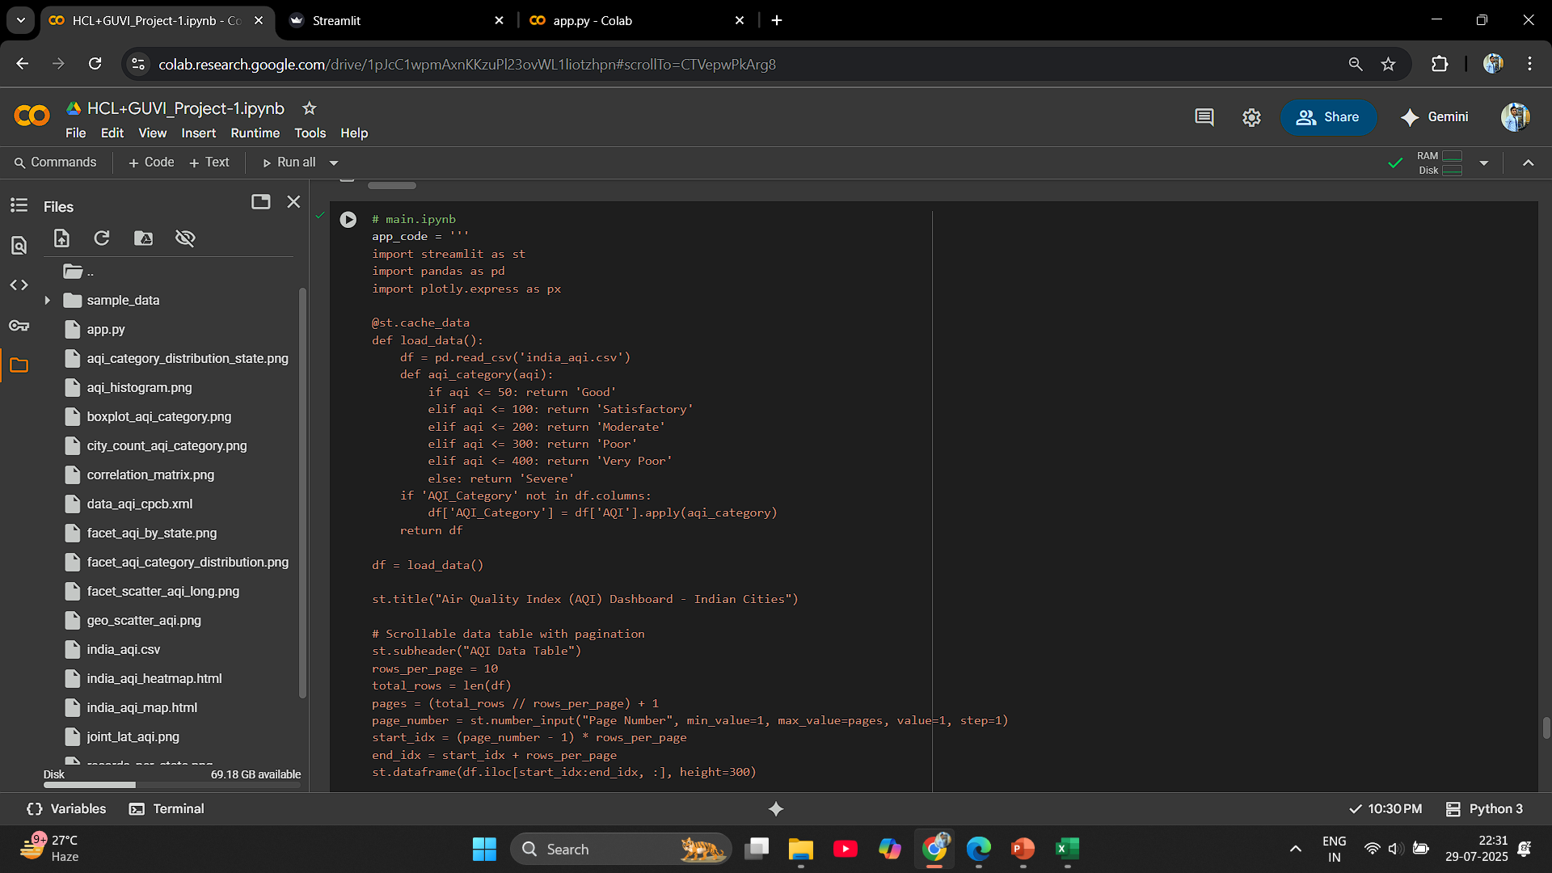

Slide 35
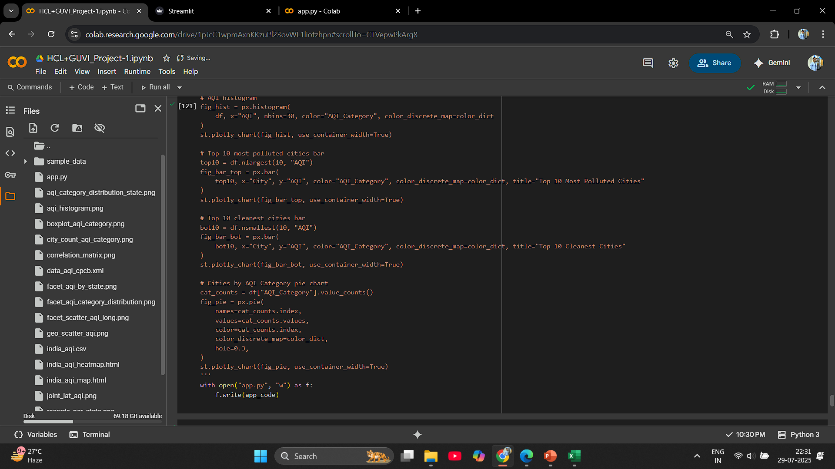

Slide 36
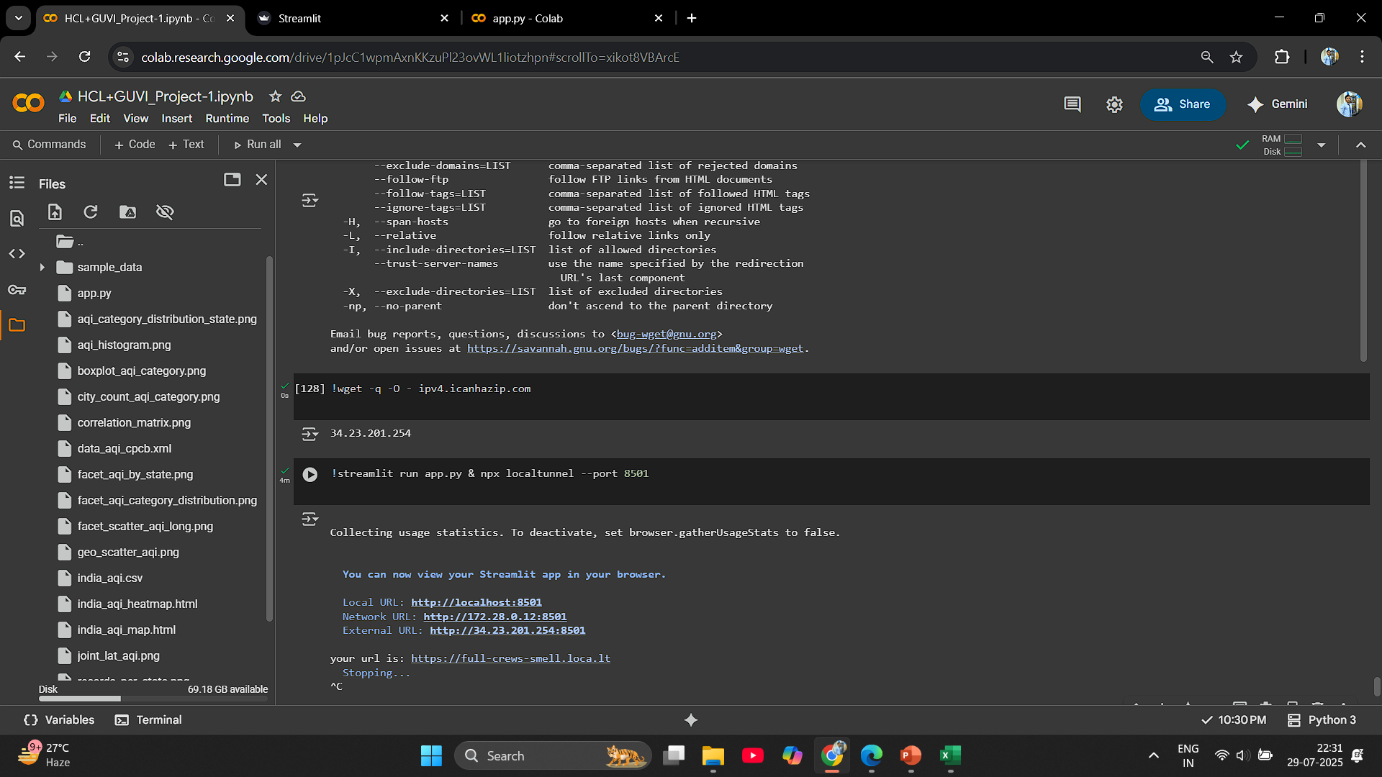

Slide 37
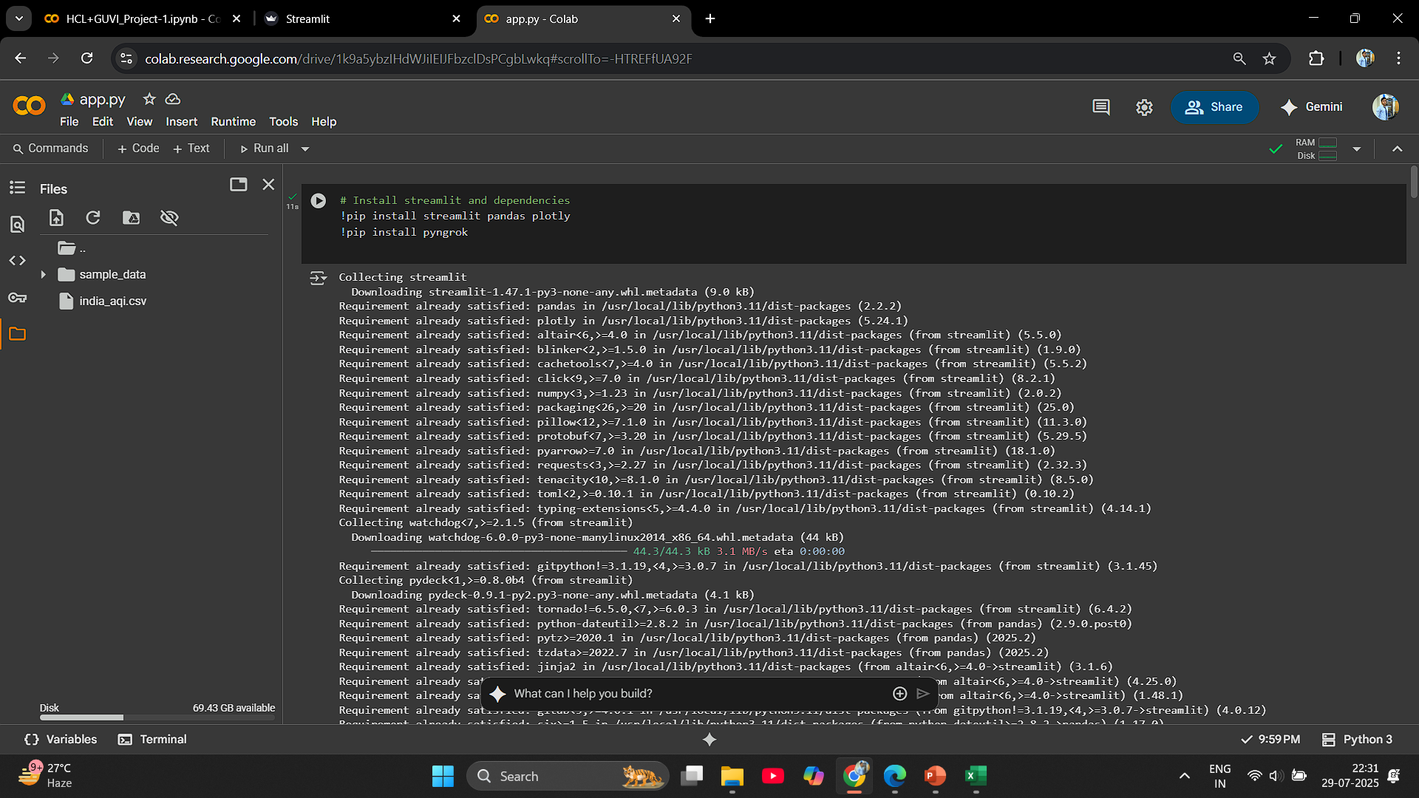

Slide 38
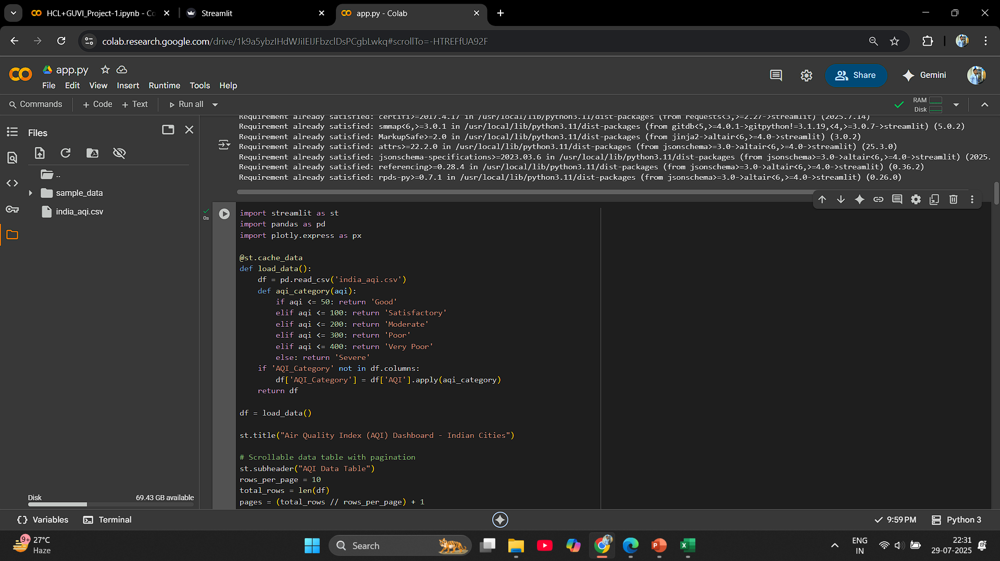

Slide 39
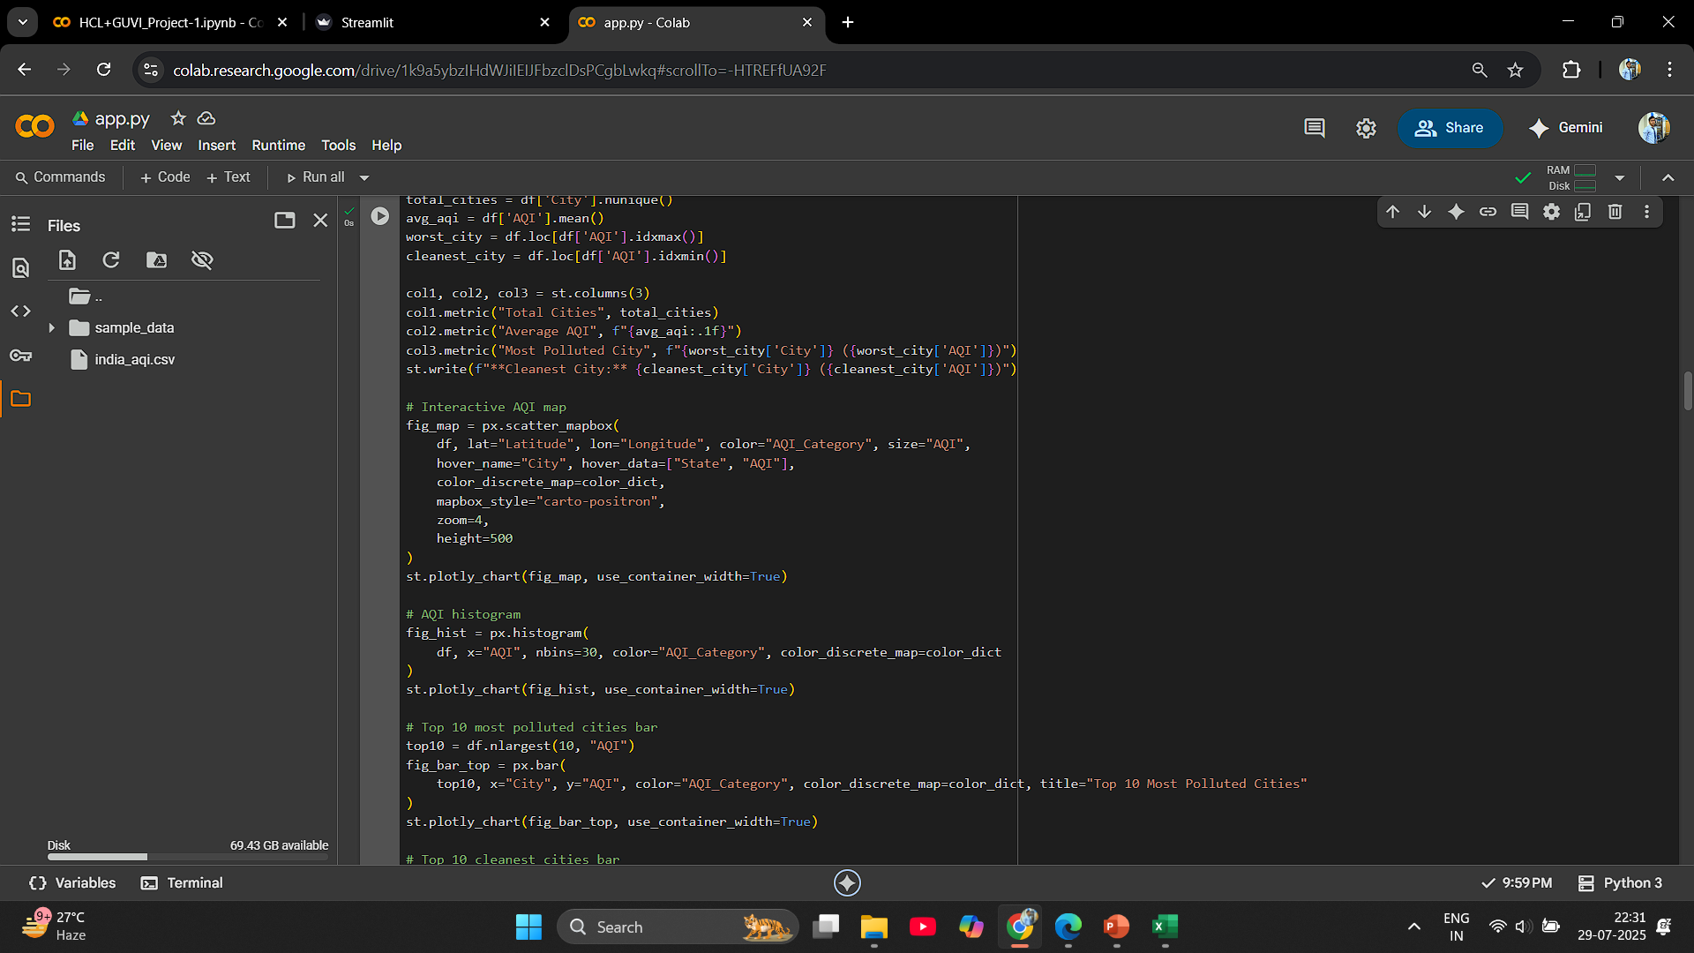

Slide 40
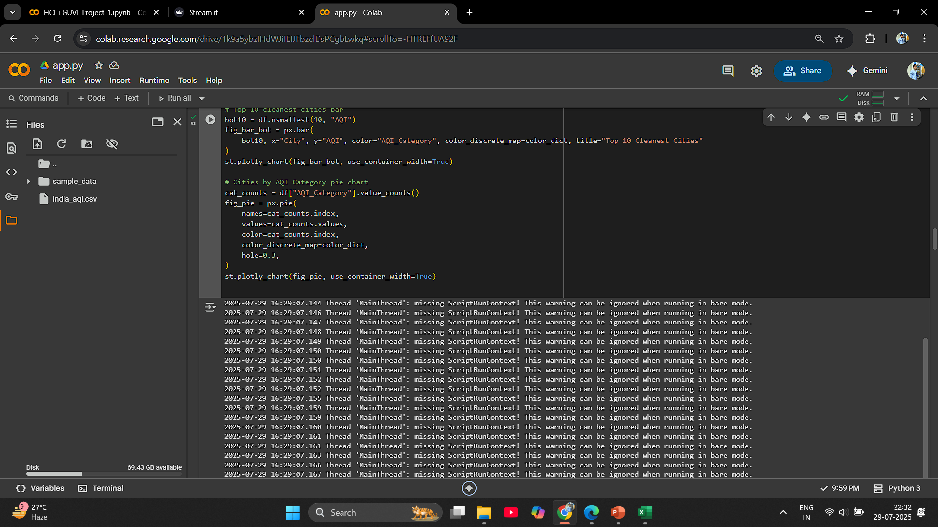

Slide 41
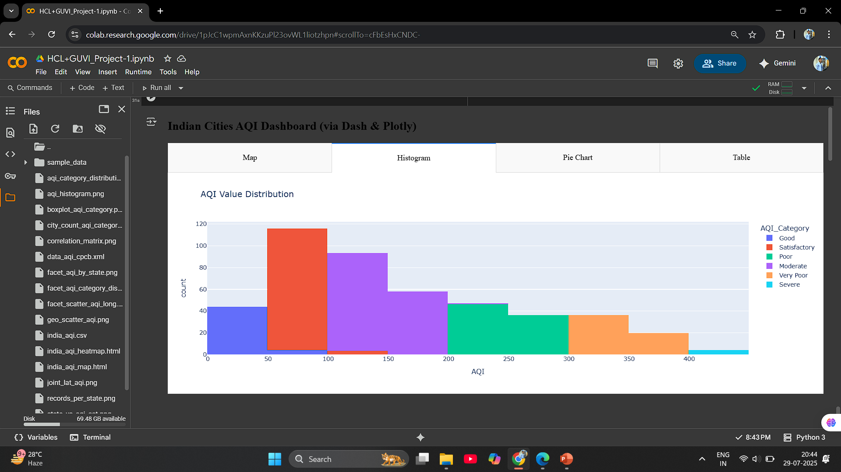

Slide 42
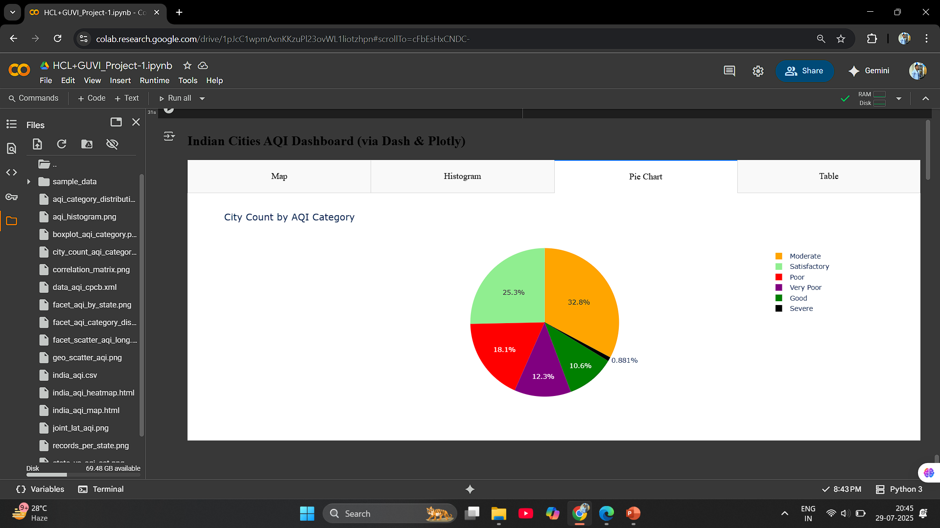

Slide 43
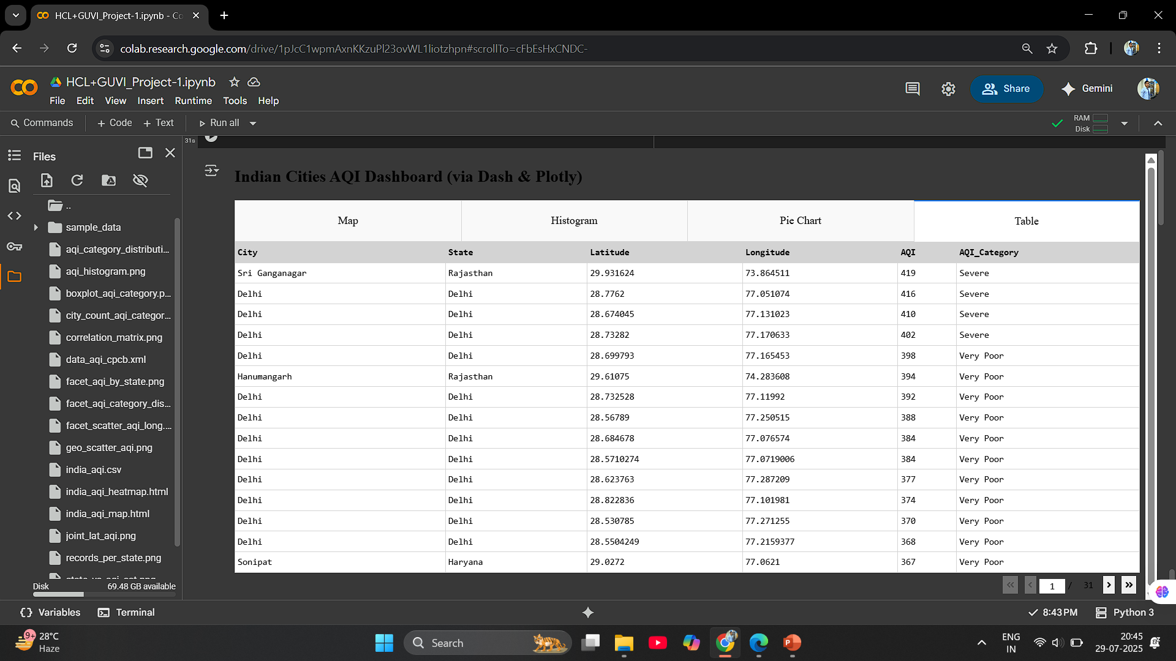

Slide 44
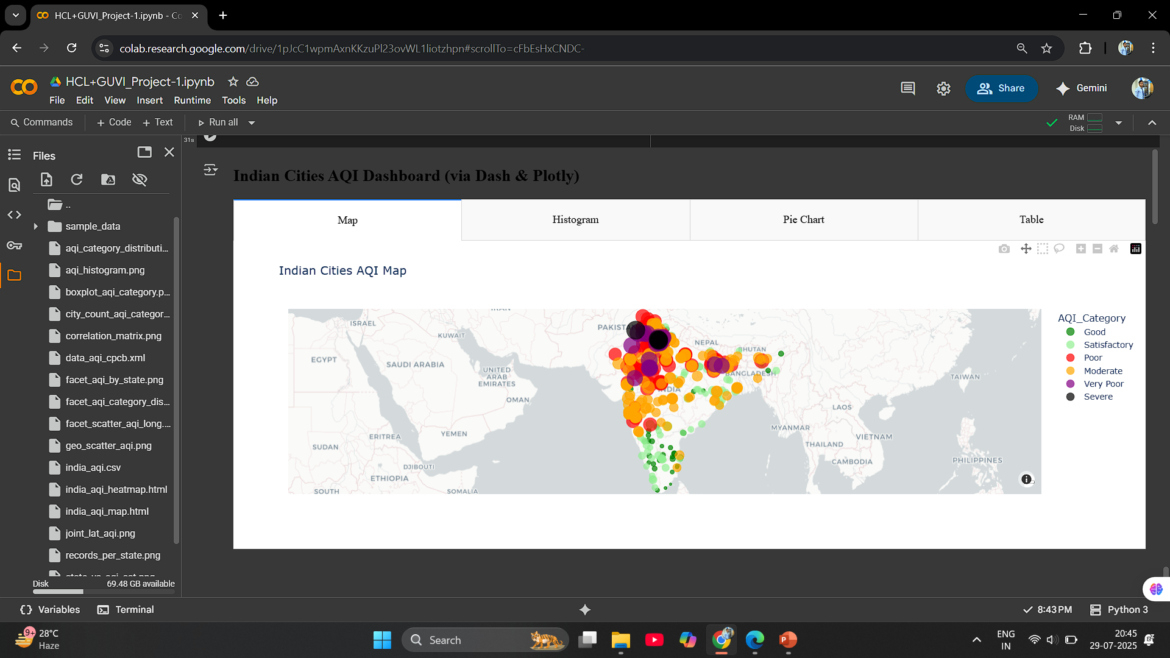

Slide 45
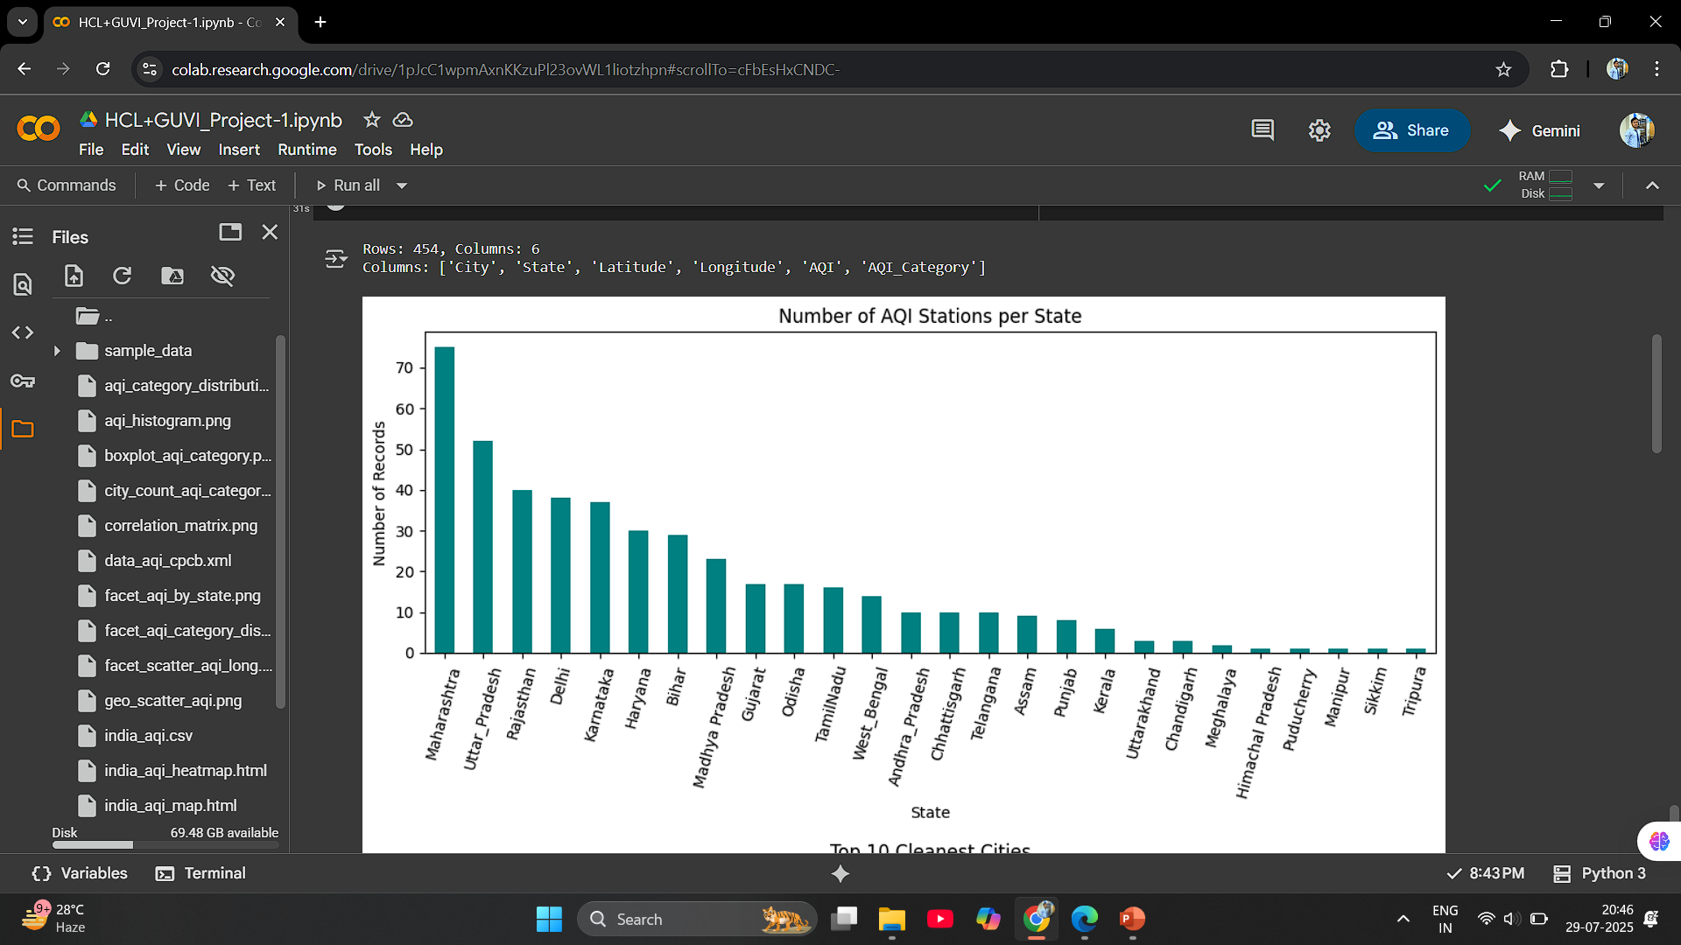

Slide 46


Slide 47


Slide 48


Slide 49


Slide 50


Slide 51


Slide 52


Slide 53


Slide 54


Slide 55


Slide 56


Slide 57


Slide 58


Slide 59


Slide 60


Slide 61


Slide 62


Slide 63


Slide 64


Slide 65


Slide 66


Slide 67


Slide 68


Slide 69
Thank You…

